Slide 1
Your logo here
Understanding energy efficiency in the NCC
NCC Tutor
© Commonwealth of Australia and the States and Territories of Australia 2022, published by the Australian Building Codes Board.
Notes:
Slide progression
The slide has a plain background and presentation title only, which provides something other than a blank screen for the time during which participants are entering the room or getting cameras and audio set up.
When you are ready to begin, click once to progress to the next slide which contains an animated intro to the module.
Facilitator notes
Add your organisation’s logo to this screen.
Copyright
© Commonwealth of Australia and the States and Territories of Australia 2022, published by the Australian Building Codes Board.
All material in this publication is licensed under a Creative Commons Attribution-ShareAlike 4.0 International Licence, with the exception of:
the Commonwealth Coat of Arms;
any logos;
any third party material;
any trademarks; and
any images or photographs.
Creative Commons Attribution-ShareAlike 4.0 International Licence is a standard form licence agreement that allows you to copy, redistribute, remix, transform and build upon the material. You must attribute the work and license the derivative works under the same terms. A summary of the licence terms is available from https://creativecommons.org/licenses/by-sa/4.0/.
Enquiries about this publication can be sent to:
Australian Building Codes Board GPO Box 2013 CANBERRA ACT 2601 Phone: 1300 134 631 Email: ncc@abcb.gov.au www.abcb.gov.au
Attribution
Use of all or part of this publication must include the following attribution:
© Commonwealth of Australia and the States and Territories 2022, published by the Australian Building Codes Board.
Disclaimer
By accessing or using this publication, you agree to the following:
While care has been taken in the preparation of this publication, it may not be complete or up-to-date. You can ensure that you are using a complete and up-to-date version by checking the Australian Building Codes Board website (www.abcb.gov.au).
The Australian Building Codes Board, the Commonwealth of Australia and States and Territories of Australia do not accept any liability, including liability for negligence, for any loss (howsoever caused), damage, injury, expense or cost incurred by any person as a result of accessing, using or relying upon this publication, to the maximum extent permitted by law. No representation or warranty is made or given as to the currency, accuracy, reliability, merchantability, fitness for any purpose or completeness of this publication or any information which may appear on any linked websites, or in other linked information sources, and all such representations and warranties are excluded to the extent permitted by law.
This publication is not legal or professional advice. Persons rely upon this publication entirely at their own risk and must take responsibility for assessing the relevance and accuracy of the information in relation to their particular circumstances.

Slide 2
Understanding energy efficiency in the NCC
Notes:
Slide progression
The slide has a short animated introduction to the module. The aim of the animation is to get the participants’ attention at the start of the module.
Facilitator notes
Welcome the trainees.
The focus of this presentation is on the fundamentals of energy efficiency and how the NCC handles energy efficiency requirements across the Volumes.
That is what you will learn about in this presentation.
Note that this presentation does not go into detail about the specific energy efficiency requirements of Volumes One or Two of the NCC. These are covered in other modules, specifically Using the energy efficiency provisions of NCC Volume One and Using the energy efficiency provisions of NCC Volume Two.

Slide 3
What you will learn
What energy efficiency means
Why energy efficiency is important
Key energy efficiency concepts & terminology
How to achieve energy efficiency
Energy efficiency requirements in the NCC
Other useful resources
Notes:
Slide progression
This slide starts with all the text in a single block on the left, and an illustration on the right.
Facilitator notes
The purpose of this slide is to prepare the trainees for the training session by quickly summarising what will be covered.
Quickly discuss the points on the screen, but don’t go into a lot of detail.

Slide 4
Why do we mean when we talk about building energy efficiency?
“…using less energy to achieve the same outcomes”
Reducing the energy required to operate a building according to its purpose
Two key aspects:
Minimising the use of mechanical heating and cooling to maintain a comfortable temperature within a building
Efficient use of power to operate a building’s services
Performance Requirements for both ‘commercial’ (Class 2-9) buildings and ‘domestic’ buildings (Class 1 and Class 10)
Specific performance required depends on factors such as the location of the building
“…the ratio between the energy used compared to the energy service actually provided, and is usually expressed as a percentage. In other words, energy efficiency is how efficiently the energy is used to provide the end-use service”
Building energy efficiency
in the NCC
“…using energy wisely and economically to sustain everyday life, live comfortably and support wellbeing”
(reducing) “…the need for energy consumption (electricity, natural gas, etc.) for heating, cooling and lighting”
Notes:
Slide progression
This slide starts with just the question in the slide banner. It has 2 layers.
Click once to bring in Layer 1 which has a heading on the left and 4 definitions on the right. The building energy efficiency title and the first quote both appear immediately. The other 3 quotes come in on a time delay.
Click a second time to dissolve out Layer 1 and bring in Layer 2, which summarises what building energy efficiency refers to in the NCC.
Facilitator notes
The purpose of this slide is to ensure that all the trainees understand what is meant when the term “energy efficiency” is used in the NCC. It starts by allowing trainees to give their own understanding of the term. It expands that understanding using 4 definitions of varying technicality. It ends by summarising the key areas and issues covered by the energy efficiency provisions in the NCC.
Note that the NCC does not contain a definition of energy efficiency.
Ask the question in the banner, and discuss the trainees’ answers. This gives more knowledgeable trainees the opportunity to demonstrate their knowledge and reduces the chances that they will feel they are being taught the basics. It also allows them to more easily tie the new knowledge they learn in the presentation to their existing knowledge.
Progress the slide to bring in the label and definitions. These present slightly different ways of defining energy efficiency, going from the more general to the more specific and building related. (All the quotes come from Australian sources. The exact sources are given below.)
Discuss these definitions, then progress the slide again to dissolve Layer 1 and bring in Layer 2, which summarises what the NCC provisions aim to achieve in terms of building energy efficiency.
Discuss the points on the slide, attempting to determine what the trainees already know about each of these points.
Some points you could discuss on this slide include:
There is no exact agreed definition for energy efficiency. The most technical definition – and source of the term – relates to how much output a machine or energy service gets for the energy that is input, i.e. how much of the energy input to a machine is lost and how much is able to be used to produce an output.
But the term is used much more broadly now in the context of reducing energy use or conserving energy.
In building terms, key sources of energy use are:
heating and cooling of the living spaces
lighting
heating hot water
operating electronic devices.
The NCC energy efficiency provisions are designed to ensure that a building is designed and constructed in such a way that it is possible to operate the building with an appropriate minimum level of energy use, given its purpose and geographical location.
There are Performance Requirements for both Class 2-9 buildings (‘commercial’) and Class1 and 10 buildings (‘domestic’).
Source of quotes:
1 “Energy efficiency means using less energy to achieve the same outcomes”
Energy.gov.au website, https://www.energy.gov.au/government-priorities/energy-productivity-and-energy-efficiency. (Accessed 9 January 2021)
2 “…the ratio between the energy used compared to the energy service actually provided, and is usually expressed as a percentage. In other words, energy efficiency is how efficiently the energy is used to provide the end-use service.”
Transformed Pty Ltd, Study materials for the Certificate IV in NatHERS Assessment.
3 “…using energy wisely and economically to sustain everyday life, live comfortably and support wellbeing”
Effectiveness of Household Energy Efficiency Interventions in Advanced Economies: What works and what doesn’t. Authors: Rebekah Russell-Bennett, Ryan McAndrew, Ross Gordon, Rory Mulcahy, Kate Letheren. Report prepared for Energy Consumers Australia organisation. https://energyconsumersaustralia.com.au/wp-content/uploads/Effectiveness-of-Household-Energy-Efficiency-Interventions-in-Advanced-Economies.pdf (Accessed 9 January 2021)
The definition is taken from another paper quoted as Butler, Gordon, Roggeveen, Waitt, & Cooper, 2016, p.152.
4 Reducing “the need for energy consumption (electricity, natural gas, etc.) for heating, cooling and lighting”
City of Fremantle, Energy Efficient Building Design, https://www.fremantle.wa.gov.au/sites/default/files/DBH12%20-%20Energy%20Efficient%20Building%20Design%20-%20D.B.H12.pdf (Accessed 9 January 2021)

Slide 5
Why is energy efficiency important?
Human induced climate change arising from greenhouse gas (GHG) emissions is a concern.
Australia’s building and construction sector is having an increasing impact on society and on our environment
Energy used in buildings accounts for around 20% of all energy related greenhouse gas emissions.
Notes:
Slide progression
This slide begins with the question in the banner, image and all the text on the slide.
Press Enter to progress to the next slide.
Facilitator notes
The purpose of this slide is to discuss why building energy efficiency is important and why the trainees should pay attention to it as builders.
Ask the question in the banner and discuss the trainees’ answers.
At the appropriate time, progress the slide to bring in the image and text.
Depending on the degree and nature of discussion, you could use the text on the slide to direct discussion or to summarise quickly and move on.
Some points that you could make on this slide include:
In recent years, awareness has increased about increasing levels of greenhouse gas (or GHG) emissions and the affect these emissions may have on global warming.
While greenhouse gases are a natural part of the Earth’s atmosphere to capture the sun’s warmth, greatly increasing the amount of GHG in the atmosphere increases this natural capture of heat, resulting in the warming the planet is seeing.
While the building sector is not the largest contributor to greenhouse gas emissions, it is one of the fastest growing sources. Energy used in buildings accounts for around 20% of all energy related greenhouse gas emissions in Australia.
The NCC aims to contribute to reducing GHGs by increasing the energy efficiency of Australia’s building stock.
Energy efficiency reduces pressure on bills in the short term because households and businesses pay for less electricity while the equipment maintains the same level of service. For example, efficient fridges can have the same features and storage capacity as minimum standard fridges but will cost less to run.
Energy efficiency also reduces pressure on prices in the future because it reduces the need to expand the electricity supply system to cope with increased demand. This means that all energy users can benefit from energy efficiency actions.
The Australian Energy Market Operator (AEMO) lists increased adoption of energy efficiency measures as one of the factors in the recent reduction of energy demand.
Source: https://www.environment.nsw.gov.au/resources/energyefficiencyindustry/130588-energy-efficiency-action-plan.pdf) Accessed 9 January 2021.

Slide 6
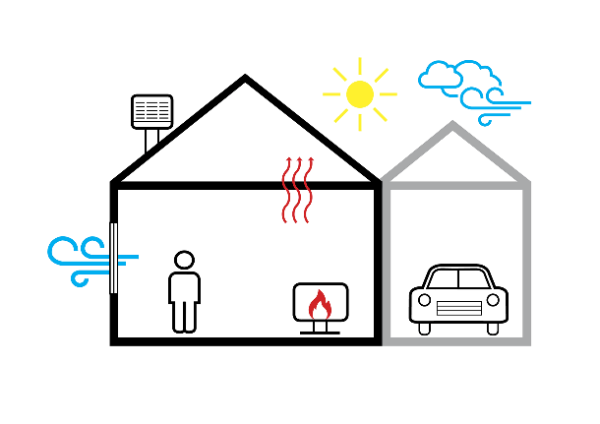
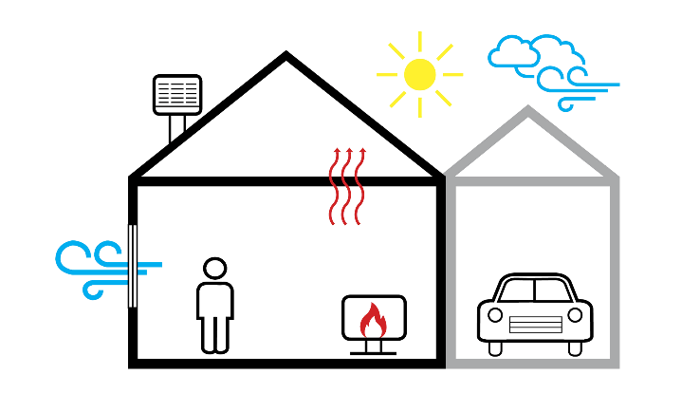
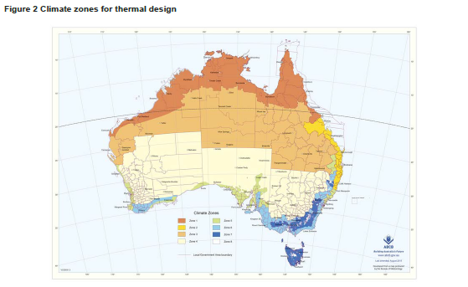
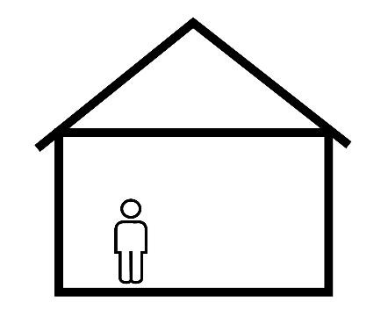
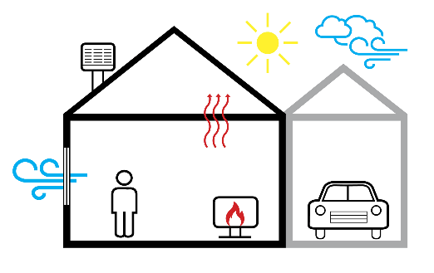
Key energy efficiency concepts 1
A building’s fabric is all the structural elements and other components used to make the building, which includes the roof, ceiling, walls, glazing and floors.
The building’s envelope consists of the parts of a building’s fabric that separate conditioned spaces from non-conditioned spaces, including other spaces inside the building and the environment outside the building.
Note that the definition of the building envelope is slightly different between NCC Volume One and NCC Volume Two.
A building’s calculated heating and cooling loads are used to determine its energy efficiency rating.
A conditioned space is essentially a space within a building which is heated or cooled by the building’s services, for example, a heating system, a cooling system or some other form of air-conditioning.
Therefore, a non-conditioned space is basically any space within a building that is not expected to be heated or cooled by the building’s services.
Note that the definition of conditioned space is slightly different between Volume One and Volume Two.
Thermal mass is a term used to describe how well a building material stores heat.
Materials with high thermal mass absorb heat from the environment and then release that heat slowly when the surrounding ambient temperature goes down.
Thermal mass exposed to winter sun warms during the day, and will warm the space it is in as it cools. Cool the thermal mass down overnight in summer and it will cool the space as it heats during the day.
Effective use of thermal mass, combined with good solar orientation, can greatly reduce the need for mechanical heating and cooling.
A building’s heating load is “the calculated amount of energy delivered to the heated spaces of the building annually by artificial means to maintain the desired temperature in those spaces.”
A building’s cooling load is “the calculated amount of energy removed from the cooled spaces of the building annually by artificial means to maintain the desired temperature in those spaces.”
In other words, heating and cooling loads are calculations of the amount of energy used to maintain the temperature in the conditioned spaces of a building.
Ventilation refers to the natural movement of air into or out of a building through an opening designed for that purpose.
This could be a:
permanent opening, such as a vent
part of a window that can open, in the wall or roof, or
door or other device that can be held open.
Good ventilation can help to cool a building naturally without the use of artificial means/energy.
The NCC recognises 8 different climate zones across Australia.
They reflect areas with similar climates, such that similar building design features can be used to improve the energy efficiency of buildings in each zone.
The specific requirements of the NCC energy efficiency Performance Requirements vary by climate zone.
Climate zones are described in Schedule 1 Definitions in any Volume of the NCC.
Cooling load
Climate zone
Ventilation
Conditioned space
Non-conditioned space
Heating load
Building fabric
Building envelope
Thermal mass
Notes:
Slide progression
This slide starts with the title in the banner and the central image on the slide.
Click any underlined term to see a popup box that explains that term.
Click the screen twice to go back to the central image.
Press Enter to progress to the next slide (from the central image page).
Facilitator notes
The purpose of this slide is to discuss some key terms relating to energy efficiency. These terms are used frequently in Parts of the NCC that discuss energy efficiency requirements, and it is difficult to understand those Parts without understanding these concepts.
Note that there are 8 terms, but only 5 popup boxes. The following terms have been explained on a single slide, because they are so closely related:
conditioned space and non-conditioned space.
heating load and cooling load.
building fabric and building envelope.
Discuss what can be seen in the image, and ask the trainees to explain what they understand by the terms used in the slide. This allows the trainees to demonstrate what they already know.
If you want to, click a term to bring up the associated explanation. This slide is designed to be used flexibly and you can choose how many of the explanations you view and discuss. For example:
If the trainees are familiar with all the terms and can explain them correctly and clearly, you might not look at any of the explanations.
If the trainees are familiar with some of the terms, but struggle to explain others, you might look just at the explanations for the problematic terms.
If the trainees are unfamiliar with all or most of the terms, then you might bring up all the explanations.
If you look at all the terms, it is probably most logical to look at them in the following order:
climate zone
conditioned space/non-conditioned space
building fabric/envelope
thermal mass
ventilation
heating load/cooling load.
If you have the time, then ask the trainees to find the relevant term in Schedule 1 of any volume of the NCC and discuss the formal definitions used within the NCC.
Things you could discuss on this slide include:
The definitions of these terms in the NCC are specific to the NCC. It is important to check the definition and make sure you understand it. Don’t rely on their everyday understanding of these terms.
Some energy efficiency terms are defined differently for NCC Volume One and NCC Volume Two. For example, the definitions of:
conditioned space
building envelope
glazing.
Climate zones:
The map is Figure 2 from Schedule 1 Definitions in any volume of the NCC. The map, together with its associated table, defines the 8 NCC climate zones for energy efficiency. There is a larger, expandable version of this climate zone map available at the ABCB website (www.abcb.gov.au), along with state and territory maps.
The different climate zones are shown by the different colours:
climate zone 1 is the dark orange colour in northern Australia
climate zone 8 is the white parts in the south east of the country.
The 8 NCC climate zones are described as:
climate zone 1 - high humidity summer, warm winter
climate zone 2 - warm humid summer, mild winter
climate zone 3 - hot dry summer, warm winter
climate zone 4 - hot dry summer, cool winter
climate zone 5 - warm temperate
climate zone 6 - mild temperate
climate zone 7 - cool temperate
climate zone 8 – alpine.
Appropriate design for the climate is key to achieving energy efficiency in a building. For example, in climate zone 1, buildings should be designed to reduce heat gain from the sun, so you want to minimise how much sun enters windows and how much heat the windows will transmit into and out of the building. Ventilation is important for cooling the building naturally. In climate zone 4, you want to minimise sun in summer and ensure adequate ventilation, but in winter when it is cooler you will usually want to maximise the amount of sun you get into the building in order to warm it naturally. In climate zone 8, where it tends to be cooler all year and very cold in winter, your main aim is to minimise the loss of warmth from inside the building.
Conditioned versus non-conditioned space:
The explanation for conditioned space on the screen is simplified a little, for space reasons, and because the purpose of this module is not to present a detailed technical analysis of energy efficiency requirements. It is sufficient in this module for the trainees to understand that some spaces in a building are conditioned and some are not.
The definition varies between Volumes One and Two. The trainees should look at the definition in the relevant Volume before making any decisions based on the classification of a space as conditioned or non-conditioned.
The NCC doesn’t define non-conditioned space, but it is logically the opposite of a conditioned space. Since the definition of conditioned space varies a little between the volumes, so does what would be considered a non-conditioned space. Check first before making any assumptions.
This classification is important because a non-conditioned space will impact on the temperature in an adjacent conditioned space, if there is a temperature difference between them. So, for example, a warm conditioned space that has non-conditioned spaces on 3 sides will lose heat to all 3 of those non-conditioned spaces. If a cool conditioned space has a warm non-conditioned space on one side (for example the western outside of the building in summer), then the conditioned space will “gain” heat from the non-conditioned space. This heat loss/gain continues between any spaces or surfaces with different temperatures, essentially until the 2 spaces/surfaces have the same temperature.
Building fabric/envelope:
The envelope of a building can be thought of as identifying the boundary between a conditioned space and a non-conditioned space.
While the building envelope is always formed from parts of the building fabric, some parts of the building fabric may not be part of the building envelope. For example, internal walls which separate conditioned spaces (i.e. rooms) from each other.
The materials used in the building fabric and the design, construction and integrity of the building envelope, help to make the building more energy efficient. They can help to reduce the transfer of heat into and out of the building. This helps to maintain a comfortable temperature in the conditioned spaces and reduces the need to use energy to heat and/or cool the building.
Using appropriate materials in the building fabric, along with appropriate insulation, can help to limit unwanted heat flow, and reduce the amount of energy needed to heat or cool the conditioned spaces in the building.
If you identify the areas of the building that are conditioned, or can be conditioned (or for Volume One) constitute a habitable room (as defined in Volume One), which is likely to be conditioned if it becomes uncomfortable, the building envelope is made up of the walls, roof, ceilings and floors that form the boundary of these conditioned spaces – if there is a non-conditioned space on the other side.
Heating and cooling loads:
A building’s heating and cooling loads are calculated using approved software.
These calculations are based on the building’s size, design, climate zone, orientation, ventilation, and the materials used in the building envelope, along with a few other factors such as any shading from other buildings or significant trees and the colours used in external materials.
Only approved software can be used to calculate heating and cooling loads, and this software is different for residential buildings versus commercial buildings, and to some extent between the different states and territories.
A building’s heating and cooling loads are the key factors that determines a building’s star rating under the various energy efficiency rating schemes. ONLY NatHERS SOFTWARE ALLOCATES A STAR RATING TO BUILDINGS. Software approved for use in H6V2 (Verification using a reference building) is unlikely to allocate a star rating.
The classification of conditioned space in a building makes a difference to the calculation of heating and cooling loads and therefore the building’s energy efficiency star rating.
Acceptable heating and cooling loads for buildings are different in different climate zones. This is an acknowledgement that it is easier to minimise energy use for heating and cooling in some climates than in other, more extreme climates. For example, it would be difficult to design a building that had no requirement at all for mechanical heating in an alpine area. To require a building in climate zone 8 to have the same heating and cooling load as a similar sized building in climate zone 1 or 4, would not be reasonable.
Heating and cooling loads and the software used to determine them is discussed in more detail later in the presentation and in the specific modules that discuss the energy efficiency provisions in Volume One and NCC Volume Two (Using the energy efficiency provisions in NCC Volume One, and Using the energy efficiency provisions in NCC Volume Two).

Slide 7
Using the NCC climate zones
3 Are these cities, of similar latitudes, in the same climate zone?
Exmouth and Dampier (WA)
Mackay and Rockhampton (QLD).
2 Are Adelaide and Perth in the same or different climate zones?
1 Which states or territories have climate zone 8 (alpine areas)?
New South Wales
Victoria
Tasmania
Both capital cities are in climate zone 5 (warm temperate).
Exmouth and Dampier = climate zone 1 (high humidity summer, warm winter)
Mackay and Rockhampton = climate zone 2 (warm humid summer, mild winter).
Notes:
Slide progression
This slide starts with the title in the banner and the image on left.
Click once to see Question 1 and click again to see Answer 1.
Click again to dissolve both Question 1 and Answer 1, and to bring up Question 2.
Click again to see Answer 2.
Click again to dissolve both Question 2 and Answer 2, and to bring up Question 3.
Click again to see Answer 3.
Press Enter to see the next slide.
Facilitators notes
The purpose of this slide is to give the trainees some practice interpreting the NCC climate zone map and table, to reinforce the concept of the different climate zones. This should be a relatively quick and simple activity that should help to demystify the idea of climate zones and how to find them.
Bring up each question in turn, discuss it, then bring up the answer and discuss the answer.
Questions and answers:
Question 1: Which states or territories have climate zone 8 (alpine areas)?
New South Wales
Victoria
Tasmania
Question 2: Are Adelaide and Perth in the same or different climate zones?
Both capital cities are in climate zone 5 (warm temperate).
Question 3: Exmouth and Dampier in Western Australia and Mackay and Rockhampton in Queensland are of similar latitudes.
Are they in the same climate zone?
No.
Exmouth and Dampier = climate zone 1 (high humidity summer, warm winter)
Mackay and Rockhampton = climate zone 2 (warm humid summer, mild winter).

Slide 8
Complete the sentences below…
heating/cooling load
A building’s __________________ represents the amount of energy required to maintain a comfortable temperature in that building.
A building’s structural elements, such as the walls, roof, ceilings, glazing and floors, are referred to as the _____________.
building fabric
A ________________ in a house is a space that can be heated or cooled to maintain a comfortable temperature.
conditioned space
A space in a house that does not have services to heat, cool or otherwise alter the temperature of the air can be described as a ____________________.
non-conditioned space
Notes:
Slide progression
This slide starts with the instruction in the banner and 4 sentences below. Each sentence has a word or phrase missing.
Click on any sentence or its radio button to see a popup which contains the missing term.
Be careful not to click outside the sentences, or you may inadvertently progress to the next slide.
Press Enter to progress to the next slide.
Facilitator notes
The purpose of this slide is to reinforce some of the key terminology by asking the trainees to select the correct term to complete each sentence.
Read each sentence, leaving out the term required, and ask the trainees to suggest the missing term. Discuss their answers, if they are not correct. Refer them to the NCC to check definitions if necessary.
Select each sentence to see the appropriate term appear in the sentence.
Note that the NCC definitions for some of these terms vary a little depending on which volume you are using, e.g. conditioned space and unconditioned space. Hence, the definitions on the slide specify that the definitions refer to a house (typically a Class 1 building).
Answers:
Option 1: A building’s heating/cooling load represents the amount of energy required to maintain a comfortable temperature in that building.
Option 2: A building’s structural elements, such as the walls, roof, ceilings, glazing and floors, are referred to as the building fabric.
Option 3: A conditioned space in a house is a space that is heated or cooled to maintain a comfortable temperature.
Option 4: Any space that does not have any services to heat, cool or otherwise alter the temperature of the air is described as an unconditioned space.

Slide 9
What term is used to describe…
…the parts of a building that separate a conditioned space from non-conditioned spaces, including the outside of the building?
The building envelope.
The design, materials and construction of a building’s envelope help to prevent unwanted transfer of heat into and out of the building.
This helps to keep the living spaces at a comfortable temperature while minimising energy use.
Notes:
Slide progression
This slide starts with all the text and images visible on the slide, except for the answer to the question.
Press Enter to bring up the answer to the question in a blue highlight box at the bottom of the slide.
Facilitators notes
The purpose of this slide is to review and reinforce the meaning of the term “building envelope”. It is a relatively simple activity but requires trainees to remember the term, rather than simply recognising it. The answer provides some additional reinforcement of the meaning of this term, and it can also be used to reinforce the distinction between the building fabric and the building envelope.
Ask the question on the slide and discuss the trainees’ answers.
At the appropriate time, bring up the answer to the question and discuss the trainees’ answers.
Things you could discuss on this slide:
The building fabric is all the structural elements and other components used to make a building, which includes the roof, ceiling, walls, glazing and floors. The parts of the building fabric that separate conditioned from non-conditioned spaces belong to the building envelope.
Not all parts of the building fabric will separate conditioned and non-conditioned spaces – some will separate non-conditioned spaces from each other, or they will separate conditioned spaces, e.g. internal walls.
Answer:
The building envelope.
The design, materials and construction of a building’s envelope help to prevent unwanted transfer of heat into and out of the building. This helps to keep the living spaces at a comfortable temperature while minimising energy use.

Slide 10
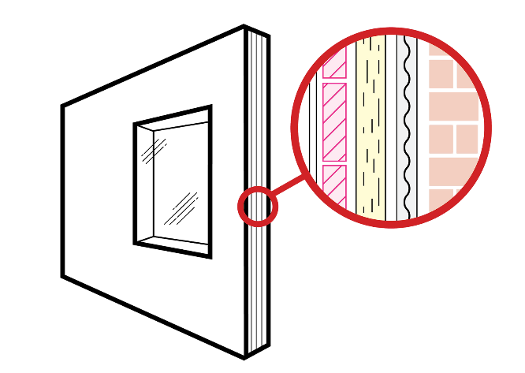
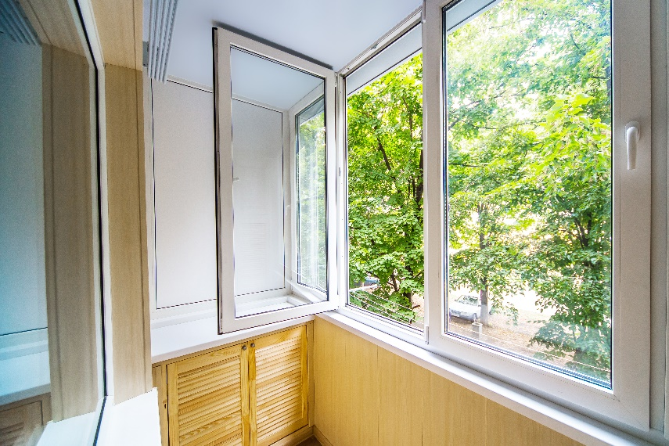
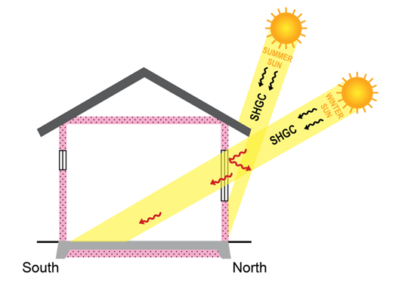
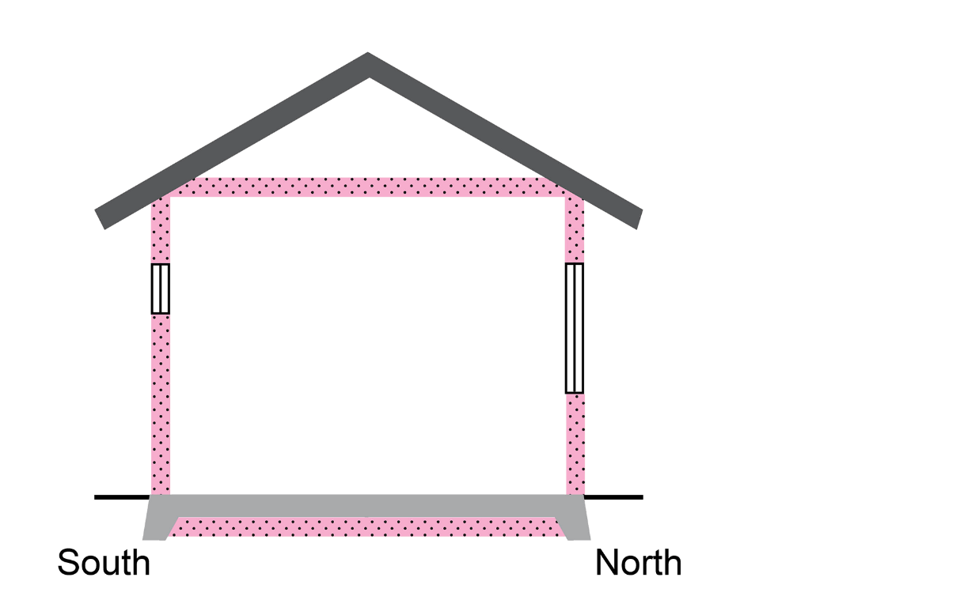
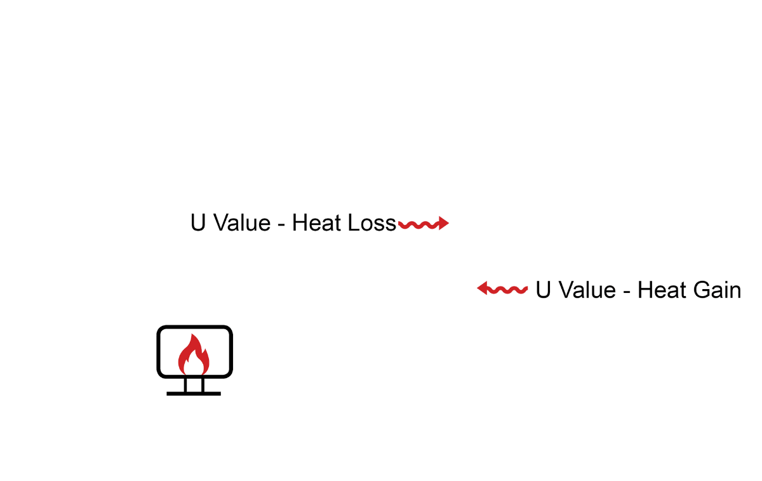
Key energy efficiency concepts 2
Glazing
Total System U-Value
Total R-Value
Solar Heat Gain Coefficient - SHGC
Glazing
In the NCC, the term glazing is used to refer to glass and the frame associated with it, in the building envelope
It can apply to windows and doors in walls, and some roof windows
There are many different types of glazing available, with different properties that can influence the energy efficiency of a building
Appropriate glazing can contribute to managing the temperature of a building, and can greatly reduce the heating and cooling load
R-Value is a measure of how well a material or building element insulates
It measures the material’s thermal resistance
The higher the R-Value, the better the material is at insulating and the less easily it transmits heat
Total R-Value of a building component or assembly is a calculation of the sum of the R-Values of the individual component layers in an composite material or assembly
Total R-Value includes any building material, insulating material, air spaces and associated surface resistances
U-Value is a measure of how easily a material or building element transmits heat
It measures the material’s thermal conductance
The higher the U-Value, the more easily the material transmits heat. The lower the U-Value, the better the material insulates
Total System U-Value of a building component or assembly is a calculation of the sum of the U-Values of the individual layers in that component or assembly
Total System U-Value includes glazing, frame, air spaces and surface resistances
SHGC is a measure of the proportion of solar energy (or solar radiation) that passes through a glazing system (the glass and the frame)
It measures the solar admittance of the glazing
A high SHGC means that the glazing system allows more solar energy/heat into a room
A low SHGC means that the glazing system allows less solar energy/heat into a room
Selecting glazing with appropriate SHGC measures can help to manage the temperature of a building and reduce heating and cooling loads
SHGC
Total System U-Value
Total R-Value
Notes:
Slide progression
This slide starts with the title in the banner and the central image on the slide.
Click any underlined term to see a popup box that explains that term.
Press Enter to progress to the next slide.
Facilitator notes
The purpose of this slide is to discuss some key terms relating to the energy efficiency of glazing and window systems. These terms are used frequently in the Parts of the NCC that discuss energy efficiency requirements, and it is difficult to understand those parts without understanding these concepts.
Things you could discuss on this slide include:
In terms of insulating properties and energy efficiency, a high R-Value is usually good, but whether you want low or high Solar Heat Gain Coefficient (SHGC) and U-Values depends on how you want the particular window to function.
So, in a northern location, where you want to keep the sun out of the building all year round, a window system with a low SHGC and low U-Value is preferred.
But in a southern location, where you might want to allow the sun into the building in winter, but exclude it in summer a high SHGC and moderate U-Value might work better.
Note that the glazing energy efficiency requirements in the NCC apply to windows in the building envelope only. So, a window in an internal wall does not have to meet these Performance Requirements. For example, a window placed high on the wall between a hallway and study to let in more light. Note that this window might have to meet other Performance Requirements, e.g. to ensure safety and minimise noise disturbance.
Glazing:
In the NCC, the term glazing includes the glass and the frame associated with it, in the building envelope.
The term is defined slightly differently between NCC Volumes One and Two.
It can apply to windows and doors in walls, and some roof windows.
R-Value/Total R-Value:
R-Value is a measure of how well a material or building element insulates, that is, how well it resists the transfer of heat from one side to the other side. It is a measure of the material’s thermal resistance.
R-value is a defined term in the NCC. The formal definition is the thermal resistance of a component calculated by dividing its thickness by its thermal conductivity.
The higher the R-Value, the better the material is at insulating. That is, the less easily it transmits heat.
The NCC also defines the Total R-Value of a building component or assembly. This is a calculation of the sum of the R-Values of the individual component layers in an composite material or assembly. The calculation includes any building material, insulating material, air spaces between the different layers, and associated surface resistances.
If you think of a pre-made exterior insulation and finish wall panel which could be assembled from 4 or 5 different layers (e.g. a metal outer layer, a foil moisture lining, an internal frame, an insulation layer and an inner shell), each of these layers will provide some degree of thermal resistance. The Total R-Value is the sum of all of these (plus the thermal resistance of any air gaps.)
Builders might not often have to calculate an R-Value, as these values are usually included in product specifications. You will usually see R-Values quoted for the building materials typically used in walls, floors, ceilings and roofs. You might need to check whether the value quoted is a Total R-Value or just the R-Value of an element. You might also need to calculate an R-Value if you are using an unusual building material or method.
For the purposes of calculating heating and cooling loads and therefore energy efficiency star ratings, it is generally the Total-R-Value of a wall, roof, ceiling or floor that matters.
U-Value/Total System U-Value:
U-Value is a measure of how easily a material or building element transmits heat from one side to the other. It is a measure of the material’s thermal conductance.
The higher the U-Value, the more easily the material transmits heat.
The lower the U-Value, the better the material is at resisting the transfer of heat. That is, the better it insulates.
A material’s U-Value is the inverse of its R-Value.
U-Values are calculated for any type of windows, including those in walls and roofs/ceilings.
The NCC defines the Total System U-Value of a building component or assembly. This is a calculation of the sum of the U-Values of the individual component layers in an composite material or assembly. The calculation includes any glazing, the frame, any insulating material in the frame, thermal breaks or air spaces between the inside and outside, any gases used (e.g. argon between double glazed windows), and associated surface resistances.
The definition of Total System U-Value varies slightly between NCC Volumes One and Two.
You will usually see U-Values quoted for glazing and window systems. You need to understand whether the value quoted is the value of the glass or frame, or a Total U-Value for the entire window system/glazing.
SHGC/Total Solar Heat Gain Coefficient:
SHGC and Total SHGC are defined terms in the NCC.
SHGC is a measure of the proportion of solar energy (or radiation) that passes through a glazing system (which includes the glass and the frame). In other words, it measure the solar heat gained through the glazing system. It is a measure of the glazing’s solar transmittance.
It is expressed as a number between 0 and 1.
A high SHGC means that the glazing system allows more solar energy/heat into a room (i.e. a value closer to 1).
A low SHGC means that the glazing system allows less solar energy/heat into a room (i.e. a value closer to 0).
A low SHGC is good in some circumstances and a higher one is better in other circumstances, depending on how the glazing needs to function in the building.
The definition of Total SHGC varies slightly between NCC Volumes One and Two.
Like the U-Value, you will usually see SHGC values quoted for glazing and window systems. You need to understand whether the value quoted is the value of the glass or frame, or a Total SHGC for the entire window system/glazing.

Slide 11
Match the term to its explanation
A transparent/translucent material and its frame in the external fabric of a building
R-Value
A measure of how easily a building element conducts heat
SHGC
A measure of the amount of heat transmitted through a window, glazed door or skylight
U-Value
A measure of how well a building element resists the transfer of heat
Glazing
Notes:
Slide progression
This slide starts with the title in the banner and 4 explanations of key terms listed below.
Click to animate the term that matches each explanation, in order from top to bottom.
The final answer animates after the fourth one, without any need for action, because the answer is obvious.
Facilitator notes
The purpose of this slide is to practice and reinforce some key terminology used in the energy efficiency provisions of the NCC. It is important to reinforce this terminology and these understandings before going on to look at the various elements in more detail this and other modules.
Read all the explanations first and all the possible answers. Give the trainees time to check the formal definitions in the NCC, if necessary.
Note that the explanations are paraphrased from the NCC definitions and the information on the earlier slide, so that the trainees really have to consider the meanings and terms carefully. (Using the exact definitions from the NCC would make the activity too easy to complete and would mean that trainees didn’t really have to think about the meanings of the terms – they would just have to recognise the formal definition on the slide. When paraphrased definitions are used, the trainees have to think about the formal definition of each term and compare it with the alternative definition and make a decision about which alternative definition best encapsulates the formal meaning.)
Then go through each explanation in order, and display the matching term as you go.
Use this activity to reinforce the meaning of each term and their relationships. For example, you could emphasise that:
U-Values and R-Values are the inverse of each other. If an element’s U-Value is high, its R-Value will be low and vice versa.
U-Values are generally given for window systems. R-Values are generally given for other kinds of building materials, e.g. materials used for walls, roofs and floors, as well as insulation.
U-Value and SHGC can be used together to tell you how a window will behave when exposed to solar radiation and heat. That is, they indicate how much solar radiation and how much heat will pass through the window.
R-Value measures thermal resistance, U-Value measures thermal conductance, and SHGC measures solar admittance.
Answers:
A transparent/translucent material and its frame in the external fabric of a building = Glazing
A measure of how easily a building element conducts heat = U-Value
A measure of the amount of heat transmitted through a window, glazed door or skylight = SHGC (Solar Heat Gain Coefficient)
A measure of how well a building element resists the transfer of heat = R-Value

Slide 12
How do we achieve energy efficiency?
Passive solar design, e.g.:
optimal orientation
appropriate use of:
thermal mass
ventilation and shading
glazing, insulation and other materials in the building fabric
Adequate building sealing to minimise air leakage
Efficiency of building systems and appliances
Requires consideration during building:
design
approval, and
construction
Shouldn’t be an afterthought - integral to design of building to ensure efficient operation
Harder and more expensive to retro-fit after construction
Notes:
Slide progression
This slide starts with just the question in the banner.
Click once to bring up the left hand block of text.
Click a second time to bring up the right hand block of text.
Press Enter to move to the next slide.
Facilitator notes
This slide summarises the key aspects required to achieve energy efficiency in a building.
Ask the question in the banner, and discuss the trainees’ answers before bringing up the other text. This allows more knowledgeable trainees’ to offer their understanding first and reduces the chance that they will think they are being taught the basics.
Progress the slide and discuss the key points at the appropriate time to reinforce necessary elements.
Things you could discuss on this slide:
Optimal orientation is key. A building that is well positioned on the block to catch winter sunshine and reduce summer sunshine - for example in southern latitudes - will be much more comfortable to live in than one that is poorly positioned, and will need far less mechanical heating and cooling. This is one of the simplest and most effective ways of obtaining good energy efficiency, although it is not enough on its own.
The materials used in the building fabric also play a role. In warmer climates, lightweight materials that reduce thermal mass can be effective. However, in cooler climates, materials with more thermal mass are usually preferred.
Glazing that is appropriate to the climate, orientation and position is also important. This involves considering more than just the type of glass and frame. It extends to the size of the glazing (windows) in different walls. In southern latitudes, large windows on the north that get winter sun can help to warm the building during the day and at night if there is sufficient thermal mass in the house. In the same situation, windows on the southern side of the building should ideally be kept smaller, as they act as a source of heat loss, regardless of the type of window used.
Insulation is also key, to reduce loss of heat in cooler weather and heat gain in warmer weather. Insulation can be in the ceiling, under the roof, under and at the sides of the floor, and in the walls. In other words, throughout the building envelope.
Ventilation is another key consideration that is often forgotten. For example, in warmer climates and in summer in most parts of Australia, good ventilation can help to clear the heat that builds up during the day and provide a comfortable temperature for sleeping at night.
In climate zones that are warm all year round (e.g. climate zones 1 and 2) good ventilation can make a big difference to how much heat builds up inside the building and to users perceptions of the thermal comfort in the building.
Shading can also be useful to consider. For example, in cooler climates positioning the building to avoid over-shadowing by neighbouring buildings in winter, and planting trees or using features such as pergolas, eaves or wing walls to reduce sun exposure and heat gain on the eastern and western sides of a building. In northern climates, where the sun can enter the building from all sides through much of the year, wider than usual eaves can help to provide shade on all sides and minimise solar heat gain.
Energy efficient building systems and appliances also play a key role. A more efficient heating system can save significantly on the energy required to heat a building, when mechanical heating is required. The key mechanical systems that contribute to energy use are:
heating and cooling
lighting
heating hot water
pumps and other equipment related to pools and spas.
Note that small appliances are also big users of energy – particularly as the number and size of devices in the typical home or workplace continues to increase and as they tend to use more and more standby power - but as they can vary, i.e. they are not a permanent fixture within the building, they are not included in assessment of energy efficiency for the purposes of building approval.
However, all efforts to minimise heat loss/gain are potentially wasted if the building isn’t well sealed, since all the warmth inside the building (in winter) will escape, and unwanted heat will enter the building in summer. Good building sealing means that if you use energy to heat your building, that warmth will be retained for longer inside the building and so the building won’t require so much mechanical heating. Ditto re cooling the building.
All of these factors listed (and others) have to be considered at the design stage, when it is cheaper and easier to ensure that the building will function well for the climate zone.
A building is approved to be built as designed, which includes all the energy efficiency features in the approved plans.
This then must be carried through in construction, i.e. the building must be built as approved and you shouldn’t be changing features that contribute to the energy efficiency of the building. For example, reducing the insulation in walls, installing ceiling insulation poorly or choosing a different material for walls or glazing, can greatly change the actual energy efficiency of the building.

Slide 13
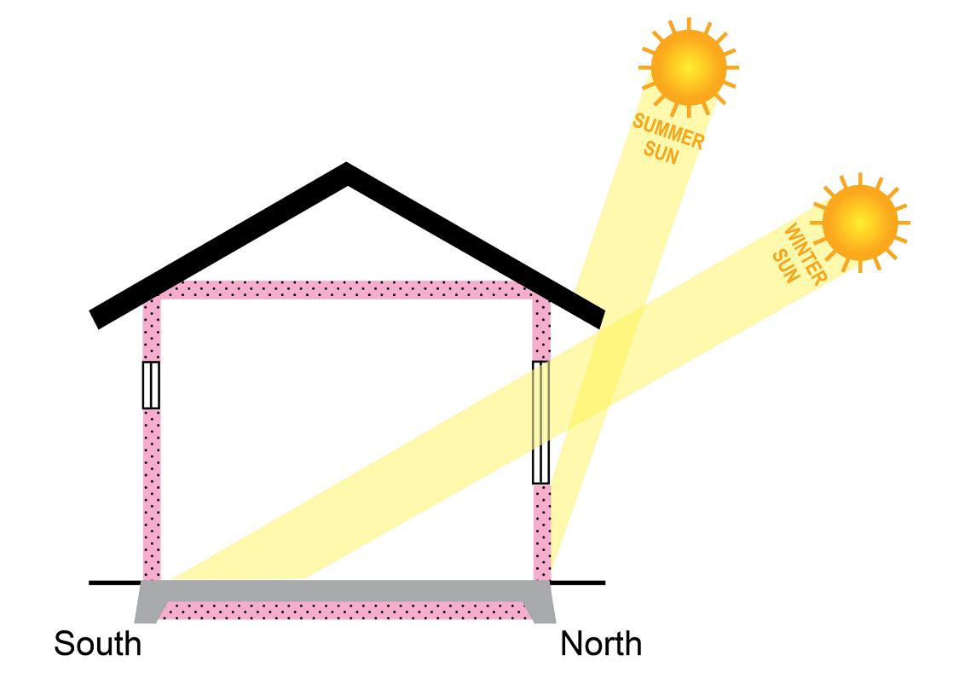
Example: Achieving energy efficiency
How does the concrete floor slab contribute to energy efficiency?
What kind of materials would you use in the building envelope? What sort of R-Value should these materials have?
What kind of SHGC and U-Values would be best for the glazing in this building?
What purpose do the eaves on the building serve?
Why is the southern window designed to be smaller than the northern window?
If you rotated this building by 90° so that the living areas faced east/west, what could be the impact on the building’s energy efficiency?
Location: Canberra
Climate zone: 7 (cool temperate)
Orientation: Ideal northern orientation for living areas
Notes:
Slide progression
This slide starts with the title in the banner and the image on the left with its associated text.
Click once to bring in the questions in the highlight box on the right.
Facilitators notes
The purpose of this slide is to put some of the preceding concepts together in a simple example. It aims to help trainees to understand how the various different factors work together to improve – or worsen – the energy efficiency of a building.
Discuss the example on the slide, i.e. what we know about the building and what can be seen in the image.
Bring up the questions and discuss them to bring out the various understandings of how things like thermal mass, building fabric, orientation, shading etc can impact on a building’s energy efficiency.
Emphasise that the design must suit the climate and respond to the orientation also.
No answers are provided, as the intention here is to stimulate discussion of the interplay of different issues, rather than to provide any definitive answer.

Slide 14
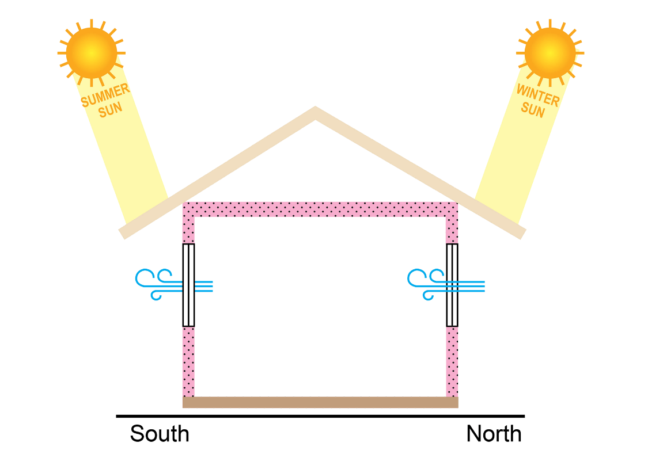
Example: Achieving energy efficiency
How is the design of this building different from the design of the Canberra building?
Why is a lightweight wooden floor used in this building?
What kind of materials could you use in the rest of the building envelope? What sort of R-Value should these materials have?
What kind of SHGC and U-Values would you select for the glazing?
Why are the northern and southern windows the same size in this building?
In what different ways can the windows contribute to the building’s energy efficiency?
Location: Cairns
Climate zone: 1 (high humidity summer, warm winter)
Orientation: Sun all year round from at least 3 directions
Notes:
Slide progression
This slide starts with the title in the banner and the image on the left with its associated text.
Click once to bring in the questions in the highlight box on the right.
Facilitators notes
The purpose of this slide is to put some of the preceding concepts together in a simple example. It aims to help trainees to understand how the various different factors work together to improve – or worsen – the energy efficiency of a building.
Discuss the example on the slide, i.e. what we know about the building and what can be seen in the image.
Bring up the questions and discuss them to bring out the various understandings of how things like thermal mass, building fabric, orientation, shading etc can impact on a building’s energy efficiency.
Emphasise that the design must suit the climate and respond to the orientation also.
No answers are provided, as the intention here is to stimulate discussion of the interplay of different issues, rather than to provide any definitive answer.

Slide 15
Energy efficiency in the NCC
Volume One
Thermal performance of the building fabric
Building sealing
Energy efficiency of building services, e.g. air-conditioning, lighting, hot water, swimming pool/spa plant
Facilities for energy monitoring
Volume Two
Thermal performance of the building fabric
Building sealing
External glazing
Air movement
Energy efficiency of domestic services, e.g. air-conditioning, lighting, hot water
Volume Three
Requirements to reduce the greenhouse gas emissions associated with heating water in buildings
Energy efficiency of water heating appliances, and the source of energy to heat water
Notes:
Slide progression
This slide starts with the main heading and the left hand block, with the first dividing line.
Click once to bring up the centre block and right hand dividing line.
Click a second time to bring up the right hand block.
Press Enter to progress to the next slide.
Facilitator notes
The purpose of this slide is to summarise the key aspects relating to energy efficiency in the NCC, and in the different Volumes.
Note that it is meant to be an overview only, to round off the module. There is more detail in other modules that discuss the energy efficiency requirements of the Volumes specifically. (Using the energy efficiency provisions of NCC Volume One and Using the energy efficiency requirements of NCC Volume Two.)
Briefly discuss the contents of the left hand block on the slide.
Progress the slide and discuss the contents of the centre block.
Progress the slide and discuss the contents of the right hand block.
Things you could discuss on this slide include:
Building energy efficiency is largely assessed by rating likely performance of the building – as designed – against a standard. A building can demonstrate compliance with the majority of NCC energy efficiency Performance Requirements by getting a rating against a nominated energy efficiency standard. (Some Performance Requirements require other forms of assessment/evidence.)
The standards that can be used to rate buildings are different for commercial and non-commercial (domestic) buildings.
There are also some differences between the standards that are acceptable in different states or territories.
Both Volumes One and Two contain Performance Requirements that focus on:
The performance of the building fabric, which means the extent to which the building fabric allows for heat flows in and out of the building.
The energy efficiency of the key, fixed building services, such as air-conditioning systems, lighting and hot water generation.
Volume One also includes requirements for the energy efficiency of swimming pool or spa plant, and provisions to allow for monitoring of energy usage.
Volume Two includes requirements for adequate sealing of the building envelope.
These inclusions reflect the key concepts and approaches discussed earlier in this module, as making a difference to building energy efficiency.
Some of the provisions in Volume Three also relate to energy efficiency. In particular, the Performance Requirements for heated water services require consideration of the amount of energy used to heat the water and the green house gas emissions that are released.

Slide 16
Other resources
Optional, non-mandatory ABCB energy efficiency calculators
Volume One calculators:
Façade
Fan systems
Glazing (SOUs)
Lighting
Pump systems
Volume Two calculators:
Glazing
Lighting
Whole-of-home
Many other useful resources available from the ABCB energy efficiency resource library:
Interactive climate zone map
Videos, e.g. how to use some calculators
Case studies
Handbooks
Notes:
Slide progression
This slide starts with the title in the banner only.
Click once to bring up the left hand block of text.
Click a second time to bring up the right hand block of text.
Facilitators notes
The purpose of this slide is to inform the trainees about available resources that could help them when working with the energy efficiency provisions of the NCC.
Discuss the information provided on the screen.
If you have the time, you can take the links to the ABCB website, to demonstrate to the trainees how to search for and locate different kinds of resources. Note that the calculators link takes you to the Resources part of the website, but with a list of all the calculators and tools below the search fields. The other link takes you to the resources part of the website, but minus this list of calculators and tools. You need to do a search to bring up any results.
Things you might want to discuss on this slide include:
ABCB has developed a range of calculators to assist practitioners to develop energy efficient building solutions.
Use of these calculators may be helpful but it is not mandatory, i.e. you do not have to use them, and they are not compliance tools or Verification Methods. For example, you can use an ABCB Glazing Calculator to identify or test glazing combinations, but you should not use the results of the calculator as the sole evidence that the glazing chosen for a building is appropriate and meets the Performance Requirements.
There are videos on how to use some calculators.
There are handbooks specifically on applying the energy efficiency provisions of each of Volumes One and Two.
There are many different case studies that cover a wide variety of topics.

Slide 17
True or False?
Sorry, that’s not correct.
The energy efficiency provisions are different in the two volumes.
Differences include the definitions of some energy efficiency terms, the Performance Requirements and the DTS Provisions.
The energy efficiency provisions are the same across Volumes One and Two of the NCC.
True
Yes, that’s correct.
The energy efficiency provisions are different in the two volumes.
Differences include the definitions of some energy efficiency terms, the Performance Requirements and the DTS Provisions
False
Notes:
Slide progression
This slide starts with the question in the banner, and a statement below, with options of True and False with radio buttons.
Click once on either the True or False option (or the radio button for either) to see a response.
Click again on the same option to get rid of the response.
Facilitator notes
The purpose of this slide (and others) is to review the content of the module. It focusses on a key point that the energy efficiency provisions of Volumes One and Two are different.
Read the statement and ask the trainees whether they think it is true or false. Discuss the trainees’ answers.
When you are ready select either True or False and click to bring up the answer.
Emphasise that, as the types of buildings covered by each volume are different, so are the Performance Requirements and DTS Provisions. Some definitions also naturally change.
Correct answer: False
Incorrect answer: True

Slide 18
Which volume/s contain provisions designed to improve building energy efficiency?
Sorry, there’s a more accurate answer. Please try again.
NCC Volume One
Sorry, there’s a more accurate answer. Please try again.
NCC Volume Three
Sorry, there’s a more accurate answer. Please try again.
Yes, that’s right. Volumes One and Two contain provisions for ensuring minimum energy efficiency levels in different types of buildings.
Volume Three contains provisions that relate to the use of energy for heating water in any type of building.
Volumes One and Two
All volumes
Notes:
Slide progression
This slide starts with the question in the banner and possible options below.
Click on any answer or its radio button to see a popup response.
Click an option/radio button a second time to remove the popup.
Be careful not to click outside the options, or you may inadvertently progress to the next slide.
Press Enter to progress to the next slide.
Facilitator notes
The purpose of this slide is to reinforce the idea that all volumes have some provisions that relate to energy efficiency. It is easy to forget about Volume Three when thinking about the energy efficiency provisions of the NCC, so this question is designed to increase the chance that trainees will remember to consider Volume Three when discussing energy efficiency considerations for buildings.
Ask the question and discuss the trainees’ answers. Refer them to the NCC if necessary. For example, if they are unsure of the coverage of energy efficiency in Volume Three, they could open that volume online and do a search on the terms “energy” or “efficiency” or “energy use”. Any of these terms should bring them to B2P7 Energy use and source. They could also find this section using the Table of Contents for Section B Water Services.
Select any option to see a response in a popup.
Correct Answer:
Option 4: Yes, that’s right. Volumes One and Two contain provisions for ensuring minimum energy efficiency levels in different types of buildings.
Volume Three contains provisions that relate to the use of energy for heating water in any type of building.
Incorrect answers:
Options 1, 2, and 3: Sorry, there’s a more accurate answer. Please try again.

Slide 19
Key points
Energy efficiency provisions in the NCC aim to reduce the energy required to operate a building, and therefore the GHG produced by buildings in Australia
Encourages:
Efficient use of energy to operate a building’s services, including heated water services
Use of low GHG energy sources
Focus on the building envelope to minimise the use of mechanical heating and cooling to maintain a comfortable temperature within a building
Different requirements for buildings in different climate zones and of different building classifications
Notes:
Slide progression
This slide starts with the main heading and the text in the top left block, with the first 2 dividing lines.
Click once to see the bottom left block appear.
Click a second time to see the top right block appear.
Click a third time to see the bottom right block appear.
Facilitator notes
The purpose of this slide is to summarise some of the key points in the module briefly.
Briefly discuss the contents of the slide.

Slide 20
Questions?
Notes:
Slide progression
This slide starts with the questions heading and 3 images.
Facilitator notes
The purpose of this slide is to act as a non-intrusive background while giving trainees the opportunity to ask any final questions.

