Slide 1
Your logo here
Understanding building classifications
NCC Tutor
© Commonwealth of Australia and the States and Territories of Australia 2022, published by the Australian Building Codes Board.
Notes:
Slide progression
The slide has a plain background and presentation title only, which provides something other than a blank screen for the time during which participants are entering the room or getting cameras and audio set up.
When you are ready to begin, click once to progress to the next slide which contains an animated intro to the module.
Facilitator notes
Add your organisation’s logo to this screen.
Copyright
© Commonwealth of Australia and the States and Territories of Australia 2022, published by the Australian Building Codes Board.
All material in this publication is licensed under a Creative Commons Attribution-ShareAlike 4.0 International Licence, with the exception of:
the Commonwealth Coat of Arms;
any logos;
any third party material;
any trademarks; and
any images or photographs.
Creative Commons Attribution-ShareAlike 4.0 International Licence is a standard form licence agreement that allows you to copy, redistribute, remix, transform and build upon the material. You must attribute the work and license the derivative works under the same terms. A summary of the licence terms is available from https://creativecommons.org/licenses/by-sa/4.0/.
Enquiries about this publication can be sent to:
Australian Building Codes Board GPO Box 2013 CANBERRA ACT 2601 Phone: 1300 134 631 Email: ncc@abcb.gov.au www.abcb.gov.au
Attribution
Use of all or part of this publication must include the following attribution:
© Commonwealth of Australia and the States and Territories 2022, published by the Australian Building Codes Board.
Disclaimer
By accessing or using this publication, you agree to the following:
While care has been taken in the preparation of this publication, it may not be complete or up-to-date. You can ensure that you are using a complete and up-to-date version by checking the Australian Building Codes Board website (www.abcb.gov.au).
The Australian Building Codes Board, the Commonwealth of Australia and States and Territories of Australia do not accept any liability, including liability for negligence, for any loss (howsoever caused), damage, injury, expense or cost incurred by any person as a result of accessing, using or relying upon this publication, to the maximum extent permitted by law. No representation or warranty is made or given as to the currency, accuracy, reliability, merchantability, fitness for any purpose or completeness of this publication or any information which may appear on any linked websites, or in other linked information sources, and all such representations and warranties are excluded to the extent permitted by law.
This publication is not legal or professional advice. Persons rely upon this publication entirely at their own risk and must take responsibility for assessing the relevance and accuracy of the information in relation to their particular circumstances.

Slide 2
Understanding building classifications
Notes:
Slide progression
The slide has a short animated introduction to the module. The aim of the animation is to get the participants’ attention at the start of the module.
Facilitator notes
Welcome the trainees.
The focus of this presentation is building classifications, which are essential to understanding and using the NCC correctly. There is one set of building classifications in the NCC, and they are used within all Volumes.
You have probably referred to different building classifications as you go about your work, or heard others talking about them, for example:
Talking about whether a building was a Class 1a building or a Class 1b building, or
Discussing whether a particular kind of building met the requirements for a Class 6 building.
Most of the requirements in the NCC apply to a specific classification - or specific classifications - of building, so you need to be able to:
Identify which classification/s any relevant building belongs to, and
Know where to go when you need an authoritative decision on which classification is most appropriate for a building, when there are arguments for it failing under more than one classification.
That’s what you will learn about in this presentation.

Slide 3
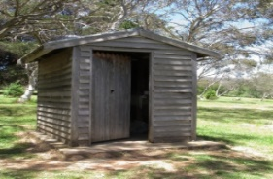
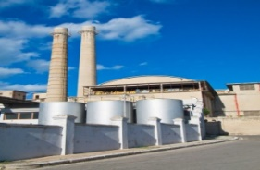
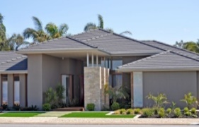
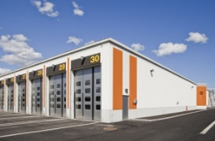
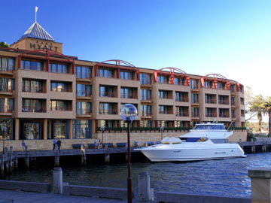
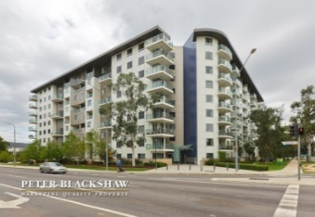
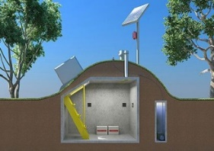
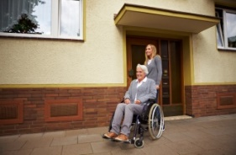
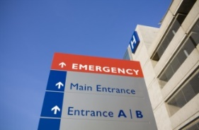
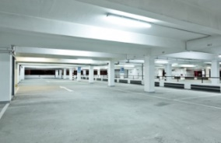
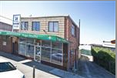
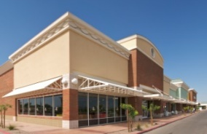
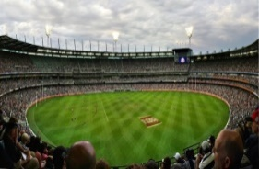
What you will learn
Where to find information about building classifications
The 10 building classifications in the NCC
Building classifications for mixed use buildings and buildings with more than one classification
Applying this to different types of buildings
Notes:
Slide progression
This slide starts with all the text in a single block on the left.
Sixteen images which illustrate the 16 different building classifications (including sub-classifications) appear on the right, in blocks of 4 at a time.
Facilitator notes
The purpose of this slide is to prepare the trainees for the training session by quickly summarising what will be covered.
Quickly discuss the points on the screen, but don’t go into a lot of detail.

Slide 4
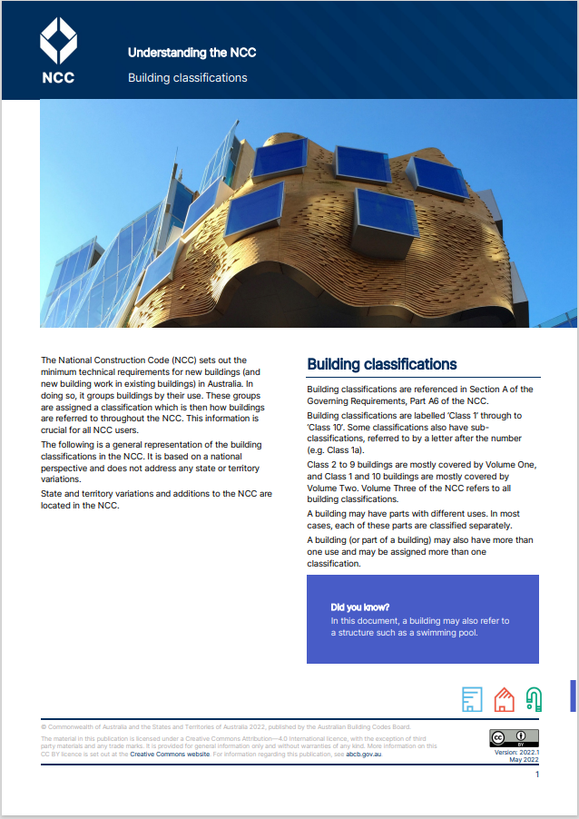
Where to find information about building classifications in the NCC
Building classifications handout, on the ABCB website (abcb.gov.au).
Governing Requirements, Part A6 in all volumes
Notes:
Slide progression
This slide starts with just the heading. It has 2 layers of content:
Click once to bring up Layer 1 with the icons for the 3 volumes of the NCC and text below it.
Click a second time to bring up Layer 2 with an image of the building classifications handout, and a link to the handout on the ABCB website.
Facilitator notes
The first question we need to answer in order to find and use the NCC building classifications is where can we find information on the different building classifications in each volume of the NCC?
Allow trainees to explain, if they know where to find the information. This helps to prevent the more knowledgeable trainees feeling like their existing knowledge is being ignored.
Progress the slide to show Layer 1 with images of all three NCC Volumes and text below.
Reinforce that:
Building classifications are in Part A6 of the Governing Requirements in each volumes.
The text is identical in all volumes. (As is all of the Governing Requirements).
If they know/have read the information on building classifications in one volume, then they have read what it says in the other volumes as well.
Part A6 contains the formal definitions of each building classification, and some explanatory information, which discusses distinctions between the classifications and gives a lot of useful examples.
Progress the slide to see Layer 2 with an image of the Building classifications handout and text.
Explain that:
The Building classifications handout is another resource they can use. It contains more explanations and examples that can be helpful, especially when trying to distinguish between 2 possible classifications.
It is available from the ABCB website.
There is a hyperlink on the name, which goes to the download page on the ABCB website. Take this link to demonstrate where the handout is, if you think it is useful.
Similarly, there is a hyperlink to the ABCB website, which you can use if you want to show trainees the website.
If possible, have trainees download/open one volume of the NCC on the ABCB website and/or the Building classifications handout, so that they can reference these documents during the training. Try to get them to use these resources and find the necessary information within it, as much as possible.
Alternatively, in a face to face session, you could give them a printed copy of one or both of these resources to reference during the training.

Slide 5
So, what are the NCC building classifications?
Volume One
Class 2 Apartments
Class 3 Hotels/motels
Class 4 Single dwelling - Class 5-9 building
Class 5 Offices
Class 6 Retail shops
Class 7a Carparks
Class 7b Storage/display warehouse
Class 8 Laboratory or factory
Class 9a Health-care building
Class 9b Assembly building
Class 9c Residential care building
Volume Two
Class 1a Single dwelling/house
Class 1b Small guest/boarding house
Class 10a Non-habitable building, e.g. a carport or garage
Class 10b Other structure, e.g. swimming pool or fence
Class 10c Private bushfire shelter
Class 1a Single dwelling/house
Class 1b Small guest/boarding house
Class 2 Apartments
Class 3 Hotels/motels
Class 4 Single dwelling in a Class 5-9 building
Class 5 Offices
Class 6 Retail shops
Class 7a Carparks
Class 7b Storage/display warehouse
Class 8 Laboratory or factory
Class 9a Health-care building
Class 9b Assembly building (e.g. school/sports stadium)
Class 9c Residential care building
Class 10a Non-habitable building (e.g. carport or garage)
Class 10b Other structure, such as swimming pool or fence
Class 10c Private bushfire shelter
Notes:
Slide progression
This slide starts with just the question. It has 2 layers:
Click once to see Layer 1 with the full list of building classifications, in order from Class 1 to 10.
Click a second time to see Layer 2 with the building classifications grouped by the volume in which you can find the relevant provisions, i.e. Volume One and Volume Two.
Facilitator notes
Ask the question and confirm appropriate answers. Most trainees will probably know some or all of the building classifications already.
Progress to Layer 1 whenever you are ready.
The purpose of this activity is to give the trainees an opportunity to bring what they already know to front of mind and demonstrate their existing competence. This serves several purposes:
Helps them to link any new information to their existing knowledge.
Reduces the chance that they feel they are being taught basics that they already know, by acknowledging their existing knowledge.
Allows the facilitator to assess how familiar trainees already are with the building classifications, and therefore what to emphasise in the rest of the training.
Explain that it is easier to discuss the different building classifications by looking at them in groups, which is how the NCC treats them. Progress to Layer 2 then summarise which classifications are covered in each of Volumes One and Two.
Discuss the different classifications on this slide, to find out how familiar the trainees are with the range of building classifications.
Note that the next slide provides a quick summary of the kind/s of buildings included in each classification, along with an illustration of the type/s of buildings. If you think you need to focus on some building classifications in particular, then you might want to progress more quickly to the next slide and have most of the discussion there.
Things you could discuss on this slide or on the next one:
Buildings are built to serve different purposes, so the way that they are designed and constructed also varies. Therefore, the requirements that they must meet also vary, in terms of things like size, space, facilities, light, how you enter them and exit from them, fire safety and structural strength.
Building classifications within the NCC reflect this variation in the purpose of different buildings, and the Performance Requirements that they must meet.
Consider:
A single family home versus an apartment block versus a backpacker hostel versus a hotel. We might sleep, relax and otherwise live in all of them, but a single family home would not successfully fill the purpose of a hotel or backpacker hostel, nor would it make for comfortable accommodation for multiple families.
An office block versus a warehouse versus a factory versus a small retail shopfront. People might work in all of these buildings, but the work they are doing varies along with the number of people who might work in each one, the number of visitors we might get, and the other materials we might keep in the space. A typical office block would make an inconvenient warehouse and a warehouse would be an uncomfortable office or shopfront, in most instances.
Because buildings have different purposes, they also need to perform differently, as a structure. They will be different sizes and shapes, they will need different numbers, sizes and shapes of rooms, they will need different amounts of light and warmth, and will need different facilities, such as bathrooms, electrical connections and lifts. They will vary in their energy and water use, their requirements for safety and security, including ways to get in and out of the buildings, and they will vary by their need to resist fire and their structural strength.
Consider the facilities required for safe evacuation of:
A single storey shop/retail building versus a multi-storey office block. Any door or window in a single storey shop may be able to be used for escape from a fire or other hazard, so there are often multiple routes for evacuation. The same is not true in a multi-storey building, where the windows are usually not able to be used for evacuation. This means that dedicated escape paths (usually fire stairs) are needed in multi-storey buildings, but not usually in single-storey buildings. The numbers of people who are likely to be in each building are also very different, resulting in different requirements for services to suppress a fire in order to allow time for people to escape.
A hospital versus a school hall. Facilities to allow for safe evacuation of people from the building would be different in these 2 buildings, because of the assumption that a large number of people in a hospital might have difficulty evacuating on their own. They may not be able to walk, use stairs or move without bringing equipment with them. While evacuating a school hall of primary school aged children might not be as easy as evacuating adults, we can assume most of them will be able to walk out of the building without assistance (although they will probably need shepherding by adults).
The NCC manages this variation in building purpose and requirements by grouping buildings by their function and use, assigning a building classification to each grouping, and specifying particular Performance Requirements for particular classifications of buildings.
Sub-classifications (e.g. 1a, 1b) are treated as separate classifications, so effectively there are 16 building classifications/sub-classifications. A Performance Requirement might apply to Class 1a, or Class 1b, or it might apply to Class 1, which means that it applies to both Class 1a and Class 1b.
Volume One is usually thought of as covering the “commercial” building classifications.
Volume Two is thought of as covering the “residential” building classifications. They may have heard people in the industry referring to Volume Two as the “Housing Provisions”.
This separation is not hard and fast. In particular, there are some disability access provisions in Volume One that may also apply to Class 1b buildings, which are otherwise covered in Volume Two.
If anyone asks/comments, confirm that the NCC building classifications are not intended to cover every possible structure that might be built, just those common buildings that are covered within the NCC itself. Some types of less-commonly built structures are not covered by the provisions within the NCC, for example power plants, water treatment plants, bridges, dams. Different legislation in the different states and territories regulates the construction of these other types of structures.

Slide 6
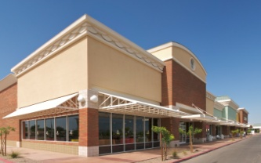
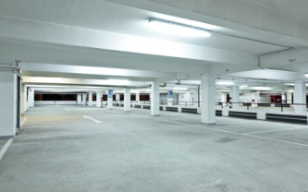
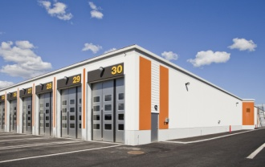
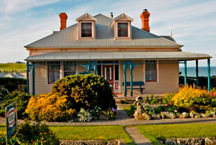
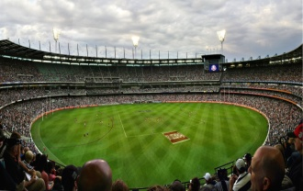
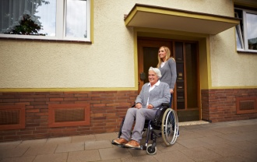
How well do you know the different building classifications?
Class 1
Class 2
Class 4
Class 6
Class 8
Class 10
Class 3
Class 5
Class 7
Class 9
Class 7a Carpark
Class 7b Storage or warehouse
Used as warehouse, wholesale display (of goods or produce).
Class 1a Single dwelling/house
Detached, row/terrace, duplex
Class 10b Structure
Fence, mast, antenna, retaining wall, pool
Class 10c Private bushfire shelter
Associated with a Class 1a building only
Class 10a Non-habitable building
Shed, carport, garage
Class 3 Residential building (not a Class 1 or 2 building or Class 4 part of a building)
For long term or transient living by unrelated people.
Hotel, motel, hostel or guesthouse, dormitory, workers’ quarters, residential care facility.
Class 5 Office building
Used for professional or commercial purposes.
Offices of lawyers, accountants, architects, government agencies.
Class 1b Boarding house, guest house, hostel less than 300 m²
Usually fewer than 12 people
Class 4 Residential part of a non-residential building
Could be a sole dwelling or a residence, e.g. caretakers’ residence.
Can only be located in a Class 5-9 building.
Class 6 Building used for the sale of retail goods or services
Retail (to the public) not wholesale
shop or shopping centre
barber or hairdresser
market
showroom
funeral parlour
Class 8 Process-type building
A building where a process or handicraft is carried out for trade, sale or gain
factory
mechanic’s workshop
abattoir or food processing plant
small or large laboratory
Class 9a Health-care building
Public or private, hospital, day care surgery, nursing home
Class 2 Apartment building
Typically multi-storey, multi-unit residential building where people live above and below each other.
Also single storey dwellings with a common space below them, such as a garage.
Class 9c Residential care building
Aged or residential care facility
Class 9b Assembly building
School, childcare centre, sports centre, night club, transport hub
Notes:
Slide progression
This slide starts with the banner and 10 buttons for the 10 building classifications (Class 1-10 buildings).
Select each button once to popup an expansion box with a description of the relevant classification and illustrative image/s in the space below.
Select the same button to close the expansion box.
MAKE SURE THAT YOU CLOSE EACH POPUP BOX BEFORE YOU OPEN THE NEXT ONE. (There is no way to ensure that any new box will appear on top of other open ones, so you need to only keep one open at a time to ensure that the one you want is visible.)
Press Enter to progress to the next slide when ready.
Facilitator notes
The purpose of this slide is to allow you to spend more time discussing the different building classifications – IF NECESSARY.
You can choose to look at all of the classifications or at none of them.
Spend only as much time as the group needs. Don’t go through all the classifications just because they are there.
If they are familiar with some or all of these classifications, then you can progress quickly. If not, spend more time on this slide.
If you have already discussed all the building classifications thoroughly on the previous slide, then you can progress straight through this slide, if you don’t think it will add any new information.
Refer trainees to the:
Descriptions of the building classifications and the Explanatory information in Part A6 in the Governing Requirements of any volume of the NCC. This is the definitive, legal statement of what each class of building covers. If in doubt, they should refer to these descriptions over any other information.
ABCB Building classifications handout, which can be downloaded from the ABCB website (abcb.gov.au). The handout contains a clear summary of all the different classifications along with some tips for distinguishing different classes of buildings.
If the group is generally familiar with the building classes already, you could review some of the additional tips on the Building classifications handout. This could help you to determine how sophisticated their understanding of the building classifications is, and to add some finer distinctions to their understandings.
Note that later slides include activities for distinguishing between different classifications, as well as dealing with buildings with mixed use buildings and buildings with multiple classifications, so don’t go into these areas in too much detail here.

Slide 7
What class is a…
Hardware store?
Class 9b
Furniture factory?
Class 1b
Mosque?
Class 8
Bed and breakfast?
Class 6
Notes:
Slide progression
This slide starts with the main heading and all 4 questions and answers. The answers are not in the correct order.
Click to animate the answer for each question, in order from top to bottom.
The final answer animates after the third one, without any need for action, because the answer is obvious.
Facilitator notes
The purpose of this slide (and the next) is to practice applying the building classifications to a range of buildings.
Go through each question in order, and display the answers as you go.
Hardware store = Class 6.
Furniture factory = Class 8.
Mosque = Class 9b.
Bed and breakfast = Class 1b.
This should not be hard but if necessary, give trainees time to refer back to Part A6 of the NCC or the Building classifications handout.

Slide 8
What class is a…
Kindergarten?
Class 7a
Shearers’ “hut”?
Class 3
Multi-storey carpark?
Class 9b
Residential care facility?
Class 9c
Notes:
Slide progression
This slide starts with the main heading and all 4 questions and answers. The answers are not in the correct order.
Click to animate the answer for each question, in order from top to bottom.
The final answer animates after the third one, without any need for action, because the answer is obvious.
Facilitator notes
The purpose of this slide (and the previous) is to practice applying the building classifications to a range of buildings.
Go through each question in order, and display the answers as you go.
Kindergarten = Class 9b.
Shearers’ hut = Class 3.
Multi-storey carpark = Class 7a.
Residential care facility = Class 9c.
This should not be hard but if necessary, give trainees time to refer back to Part A6 of the NCC or the Building classifications handout.

Slide 9
Which of the following is a Class 1a building?
Class 1a
Single, detached dwelling above a single garage for that dwelling.
Class 2
An apartment complex.
Class 1a
A row of terrace houses, with common fire walls between them, each with an attached garage.
Class 2
A 3 storey building with a shared underground garage and a residential sole occupancy unit on each storey, not including the garage.
Notes:
Slide progression
This slide starts with the question in the banner and all the possible options.
Click on any option or its radio button to see a popup that lists the relevant classification.
Click each option/radio button a second time to remove the popup.
Be careful not to click outside the options, or you may inadvertently progress to the next slide.
Press Enter to progress to the next slide.
Facilitator notes
The purpose of this slide (and the next) is to practice and reinforce the differences between building classifications that might be easily confused.
Ask the question and discuss the trainees’ answers. Refer them to Part A6 of the NCC or the Building classifications handout, if necessary.
Select an option to see its building classification in a popup.
Answers:
Options 1 and 3 are both Class 1a buildings.
Options 2 and 4 are both Class 2 buildings.

Slide 10
Which class is each of the following buildings?
Class 3
Accommodation for visiting doctors in a rural hospital.
Class 1b
Six single dwellings on one block that are used for holiday stays.
Class 2
A row of terrace houses, with common fire walls between them, and a common underground garage.
Class 4 part of a building
A caretaker’s flat in a warehouse or office building.
Notes:
Slide progression
This slide starts with the question and a list of buildings.
Click on any option or its radio button to see a popup that lists the relevant classification.
Click each option/radio button a second time to remove the popup.
Be careful not to click outside the option, or you may inadvertently progress to the next slide.
Click anywhere else on the slide or press Enter to progress to the next slide.
Facilitator notes
The purpose of this slide is to practice and reinforce the differences between building classifications that might be easily confused.
Ask the trainees the classification of each building, and discuss their answers. Refer them to Part A6 of the NCC or the Building classifications handout, if necessary.
Select an option to see its building classification in a popup.
If the trainees’ understanding is good overall and they are interested, then consider discussing the “Difficult classifications” section of the Explanatory information in Part A6 of any Volume of the NCC. This section discusses some more fine distinctions that can sometimes make the classification of a building complex.
If trainees are relatively inexperienced with building classifications or seem uninterested in the fine detail, for example because they only ever work on smaller residential projects, then just point out that the Explanatory information in Part A6 of any Volume of the NCC contains examples and discussion of more complex cases.
Option 1 is a Class 3 building.
Option 2 is a Class 1b building.
Option 3 is a Class 2 building.
Option 4 is a Class 4 part of a building.

Slide 11
What about Volume Three?
Volume One covers Class 2-9 buildings.
Volume Two covers Class 1 and 10 buildings.
Volume Three covers plumbing and drainage requirements for all building classifications.
Notes:
Slide progression
This slide starts with the question in the banner and icons and text summarising the building classifications covered in Volumes One, Two and Three of the NCC.
Facilitator notes
This slide is simple in format and short to complete. It conveys an important point but also acts as a cognitive rest point, after a series of content-rich slides and several detailed activity slides.
Ask the question and discuss the trainees’ answers.
Designers and builders building any class of building will need to refer to Volume Three for Performance Requirements related to plumbing and drainage.
If this came up earlier and was discussed in any detail, then progress straight through this slide.

Slide 12
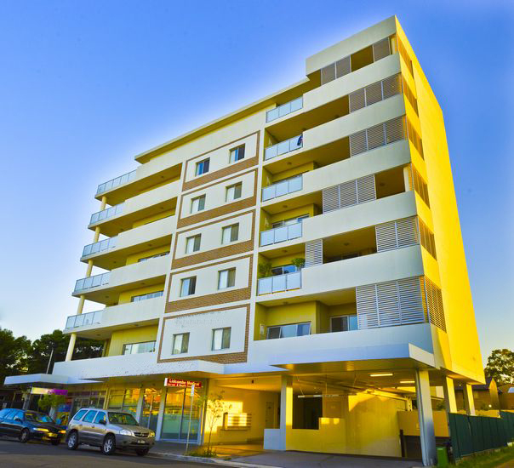
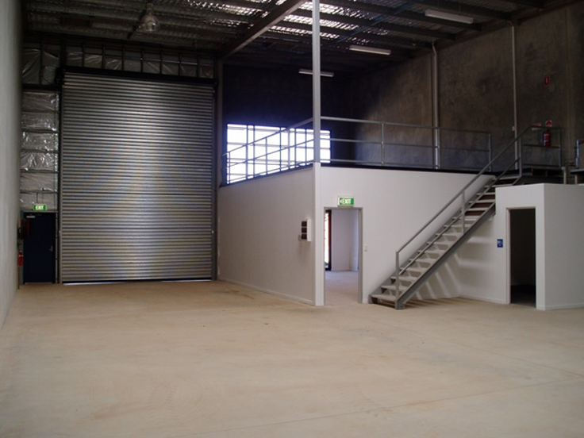
Mixed use buildings
The 10% rule generally applies:
<10% of floor area of a storey means the primary classification applies to the whole building.
Doesn’t apply to some spaces where safety and amenity considerations are paramount, such as:
Laboratories.
Sole occupancy units in Class 2, 3 or 4 buildings.
Class 9b early childhood centre.
Each part must be classified separately.
The relevant Performance Requirements must be applied to each part.
Refer to clause A6G12 Multiple classifications
Apartments
(Class 2)
Shops
(Class 6)
Carpark
(Class 7a)
Notes:
Slide progression
This slide has 2 layers:
It starts with the title in the banner and Layer 1 visible. This contains some descriptions and an image of an apartment building with shops and parking garage.
Click to see Layer 2 with a different example of a mixed use building, which is a warehouse with office space. This layer also has a description of the 10% rule.
Facilitator notes
The purpose of this slide is to summarise the rules for mixed use buildings, which are those with different spaces that are used for different purposes and which therefore can have different classifications.
Use Layer 1 to discuss the concept of mixed use buildings and reinforce the 3 bullet points on the slide.
Progress to Layer 2 to discuss the 10% rule, and the exception to that rule for spaces such as laboratories or sole occupancy units (SOUs) in Class 2, 3, or 4 buildings.
Note that some other examples of mixed use buildings are given on the next slide.
During the discussion, emphasise that:
Each part is classified separately according to its purpose.
Each part must meet all the Performance Requirements for its particular classification.
Generally, if a part of a building that has a different purpose is less than 10% of the total floor area of the storey it is on, then it is not given a separate classification. The classification of the rest of the building, or space it is within, applies. In the NCC, this is provided as an exemption to clause A6G1.
For example:
In a single storey warehouse with an office that is 15% of the total floorspace, the office space has a separate classification – Class 5 – and that space must meet the Performance Requirements for a Class 5 building.
If the office space was only 5% of the total floorspace, then it would be classified, along with the rest of the warehouse, as a Class 7b building, and would have to meet the Performance Requirements for a Class 7b building.
If the warehouse had 2 storeys and the office was 15% of the ground floor, but only 7.5% of the total floorspace, then the office space would still be considered a Class 5 part of the building, because it is the percentage of the floorspace of the storey it is on that matters, not the total percentage.
The 10% rule doesn’t apply to :
Laboratories. A laboratory (usually a Class 8 building) is considered to have a high fire risk which must be appropriately managed. Treating a laboratory like another class of building would potentially mean that fire hazard management measures might be inadequate for the risk the laboratory poses to users of the building.
A sole-occupancy unit in a Class 2 or 3 building or a Class 4 part of a building. When any space is used for people to live in, the NCC mandates Performance Requirements to manage fire risks and ensure adequate sound insulation. Treating an SOU like another class of building could mean reducing these requirements, which would result in a living space that failed to comply with requirements and lacked necessary amenities.
9b early childhood centres. Early childhood centres generally pose a different set of risks, especially in emergency evacuation, than other building classifications. Treating an early childhood centre like another class of building could mean that the fire safety measures do not match the risk and occupancy characteristics of this building classification.
More discussion of the 10% rule and exceptions to the rule can be found in the Explanatory information in Part A6 of any volume of the NCC.
Refer trainees to Part A6 of the NCC or the Building classifications handout, if necessary.

Slide 13
What about…
A shopping centre with shops on the ground floor and 2 floors of car parking above?
A hospital with a child care centre?
A church with an attached priest’s residence?
A boiler room or machinery room in the basement carpark of an office building?
Notes:
Slide progression
This slide starts with the title in the banner and the first example in the top left block.
Click to bring up the second example in the bottom left block.
Click a second time to bring up the third example in the top right block.
Click a third time to bring up the fourth example in the bottom right block.
Facilitator notes
The purpose of this slide is to further discuss the concept that buildings and/or spaces can have multiple classifications.
All are examples of buildings that would most likely have more than one classification (depending on a few factors like the space percentages and the purpose/use of each space.)
Refer trainees to Part A6 of the NCC or the Building classifications handout, if necessary.
Spend the amount of time the group needs on this slide. If they are comfortable with the idea of multiple classifications, then you might progress quickly through this slide and just briefly give the classifications for each example. If the idea of parts of a building having multiple classifications is new to them, then you might want to spend longer on this slide.
For example, you could have them look up and suggest the classifications for each example, and discuss in detail the factors that would determine whether one or two classifications applied, e.g. the “10% rule”.
Discussion notes
A shopping centre with shops in the ground floor and 2 floors of car parking above = Class 6 (retail shops) and Class 7a (carpark).
A church with an attached priest’s residence = Class 9b (church) and Class 4 part of a building (residence).
A hospital with a child care centre = Class 9a (health care building) and Class 9b (childcare centre = assembly building).
A boiler room or machinery room in the basement carpark of an office building = Class 7a as no special classification is needed for a boiler room or machinery room (regardless of their size or percentage of the floor space). HOWEVER, there are specific Performance Requirements for the construction of these kinds of rooms, e.g. fire separation requirements. See Volume One for the specific Performance Requirements. If you have time and the trainees are interested, you could ask the trainees to look at Volume One and find the location of these special provisions for boiler rooms etc.

Slide 14
Can a whole building have multiple classifications?
Yes, it’s possible, if the building is designed to serve multiple purposes.
For example, a building with spaces that could be used for offices, or retail sales or storage.
Must be designed to meet:
All specific Performance Requirements for any class, and
The most stringent Performance Requirements of all applicable classes.
Notes:
Slide progression
This slide starts with the question only.
Click to bring in the text in the left hand block and the dividing line.
Click again to bring in the text in the right hand block.
Facilitator notes
Ask the question and discuss the trainees’ answers.
Discuss the situation in which a builder wants to build a building that has flexibility in its use, i.e. can be used for different purposes. For example, a building with a number of units in an industrial park. The building owner/developer might want to be able to sell or rent the units in the building for a variety of purposes such as:
Office space for small businesses (Class 5)
Retail space for businesses that sell to the public (Class 6)
Storage space (Class 7b).
This is permissible but the building must meet all the specific requirements for any class and the most stringent requirements of all the classes.
For example, a storage space might not need to have a lot in the way of facilities, such as bathrooms, because typically few people work in these spaces.
However, an office or retail space requires a minimum number of bathrooms (determined by the expected number of users and size) because there is an expectation that some people will typically spend long periods of time in the space, and that a larger number of people will use the space.
Therefore, the units would need to meet the more stringent facility requirements for Class 5 and Class 6 buildings.

Slide 15
What if a building’s classification isn’t obvious?
If the most appropriate classification for a building is not clear, the appropriate authority must classify the building as belonging to the class it most closely resembles.
The appropriate authority means, “The relevant authority with the statutory responsibility to determine the particular matter.” (NCC, Schedule 1, Definitions, in any Volume.)
Notes:
Slide progression
This slide starts with the question only.
Click to bring in the text in the left hand block and the dividing line.
Click again to bring in the text in the right hand block.
Facilitator notes
Ask the question and discuss the trainees’ answers.
Display the text on the slide and discuss.
Emphasise that:
Building classification is a risk management issue. The risk associated with a building’s intended purpose needs to be assessed so that the building can be classified appropriately and built to meet the most appropriate Performance Requirements.
When deciding on a building’s classification, the appropriate authority reviews the building proposal and might consider the:
Intended purpose of the building, and/or different parts of the building.
Building classification that the building most closely resembles.
Likely fire load of the building.
Likely risks to the safety, health and amenity of the people who might use the building.
Relevant decisions or determinations by appeals courts in the relevant state or territory. (Note that not all appeals court decisions set precedents.)
The definition of appropriate authority is slightly different in NSW.
Some building regulatory authorities in some states and territories issue their own guidelines for building classification.
A building surveyor is one of the main appropriate authorities to classify a building, but it could also be a council and that this should be confirmed with the local regulator.
Discuss who the appropriate authority might be in the state or territory that the trainees work in. Generally, it will be whichever body approves building applications. This body must approve a building’s classification, including when different parts of a building have different classifications, and when a space or a whole building has multiple classifications.
But you would not wait to submit a full application before getting an indication of the suitability of a building’s classification, if there is any uncertainty. It is useful to get an indication of the likely decision before completing full plans and building application.

Slide 16
How would you classify…
A retail shop with a residence at the back??
Retail building = Class 6
Residence = Class 4 part of a building
Residence
Retail
Storage
Notes:
Slide progression
This slide starts with the title in the banner and the rest of the question and an image below.
Click to see the answer to the question on the right.
Facilitator notes
The purpose of this slide (and following ones) is to review the content of the module.
Ask the question and discuss the trainees’ answers. Refer trainees to Part A6 of the NCC or the Building classifications handout, if helpful.
When you are ready, click to bring up the answer.

Slide 17
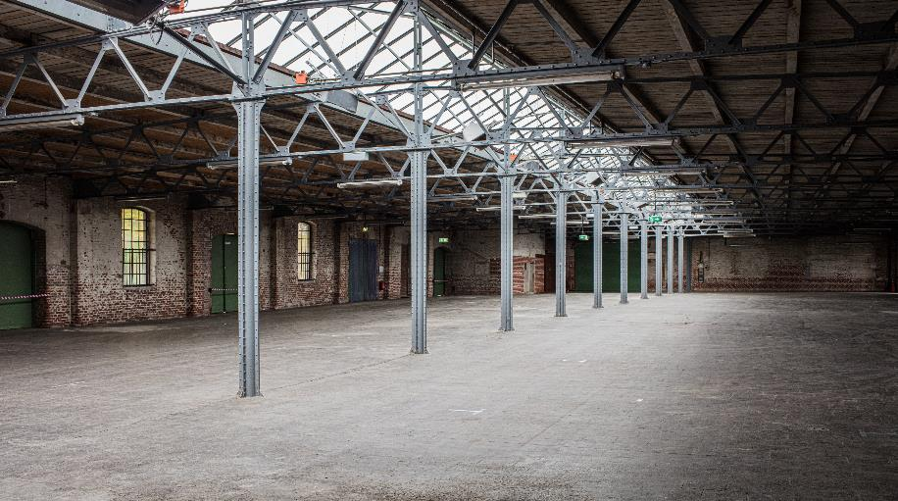
How would you classify…
A building that could be used as a warehouse or for light industrial activities?
Both Class 7a and Class 8
Notes:
Slide progression
This slide starts with the title in the banner, and the question and an image below.
Click to see the answer to the question on the right.
Facilitator notes
The purpose of this slide (and others) is to review the content of the module.
Ask the question and discuss the trainees’ answers. Refer trainees to Part A6 of the NCC or the Building classifications handout, if helpful.
When you are ready, click to bring up the answer.

Slide 18
How would you classify…
A building with squash courts, a small sports association office, and a café taking up 30% of the building?
Sports centre = Class 9b
Café = Class 6
Office = Class 9b
(<10% of floor area)
Court 8
Court 7
Court 6
Court 5
Bathroom
Bathroom
Café/restaurant
Office
Court 1
Court 2
Court 3
Court 4
Kitchen/prep
Notes:
Slide progression
This slide starts with the title in the banner, and the rest of the question and an image below.
Click to see the answer to the question on the right.
Facilitator notes
The purpose of this slide (and following ones) is to review the content of the module.
Ask the question and discuss the trainees’ answers. Refer trainees to Part A6 of the NCC or the Building classifications handout, if helpful.
When you are ready, click to bring up the answer.

Slide 19
What class is a…
Pottery studio?
Class 6
Service station?
Class 9b
Railway station?
Class 7b
Warehouse?
Class 8
Notes:
Slide progression
This slide starts with the main heading and all 4 questions and answers. The answers are not in the correct order.
Click to animate the answer for each question, in order from top to bottom.
Note that the final answer animates after the third one, without any need for action, because the answer is obvious.
Facilitator notes
The purpose of this slide is to review the application of the building classifications to a range of buildings.
Go through each question in order, and display the answers as you go.
Pottery = Class 8
Service station = Class 6
Railway station = Class 9b
Warehouse = Class 7b
Note that a service station is Class 6, but a car repair workshop (e.g. a motor mechanic, panel beater, tyre replacement) is likely to be a Class 8.
This should not be hard but if necessary, give trainees time to refer back to Part A6 of the NCC or the Building classifications handout.

Slide 20
True or False?
Sorry, that’s not correct.
You need to refer to Volume Three for plumbing and drainage provisions.
Also, some of the disability access and fire provisions in Volume One may apply to a Class 1b building.
You are building a small hostel (Class 1b) on the coast.
You can find all the relevant Performance Requirements in Volume Two of the NCC.
True
Yes, that’s right.
You need to refer to Volume Three for plumbing and drainage provisions.
Also, some of the disability access and fire provisions in Volume One may apply to a Class 1b building.
False
Notes:
Slide progression
This slide starts with the question in the banner, and a statement below, with options of True and False with radio buttons.
Click once on either the True or False option (or the radio button for either) to see a response.
Click again on the same option to get rid of the response.
Facilitator notes
The purpose of this slide (and others) is to review the content of the module.
Ask the question and discuss the trainees’ answers. Refer trainees to Part A6 of the NCC or the Building classifications handout, if helpful.
When you are ready, click to bring up the answer.

Slide 21
A boarding house or hostel could be a Class 1b building or a Class 3 building. What key factor/s determines its class?
No, there are no restrictions on the height of either Class 1b buildings or Class 3 buildings. Try again.
Height in storeys. A Class 3 building is typically a high-rise building while a Class 1b building is typically a low-rise building.
No, both Class 1b and Class 3 buildings are designed to accommodate unrelated people. Try again.
Who will live/stay there. A Class 3 building is designed to accommodate unrelated people while a Class 1b building may accommodate related or unrelated people.
Yes, that’s right.
How many people it can accommodate and total floor area. A Class 1b building would normally not accommodate more than 12 people, and would have a total floor area of no more than 300 m². If bigger than this, it would be classed as a Class 3 building.
Notes:
Slide progression
This slide starts with the question in the banner and possible options below.
Click on any answer or its radio button to see a popup that discusses whether the statement is accurate.
Click an option/radio button a second time to remove the popup.
Be careful not to click outside the options, or you may inadvertently progress to the next slide.
Press Enter to progress to the next slide.
Facilitator notes
The purpose of this slide is to practice and reinforce the differences between building classes that might be easily confused.
Ask the question and discuss the trainees’ answers. Refer them to Part A6 of the NCC or the Building classifications handout, if necessary.
Select an option to see a response in a popup.

Slide 22
True or False?
Yes, the statement is true.
If a residence is built over any other type of structure it would be a sole-occupancy unit of a Class 2 building.
This is the case, even if the other structure is a common garage space.
A Class 1a residence cannot be built over or under another building or structure of any other class, except for a private garage.
True
Sorry, the statement is true.
If a residence is built over any other type of structure it would be a sole-occupancy unit of a Class 2 building.
So, two single storey units built over a common garage are both Class 2 sole-occupancy units.
False
Notes:
Slide progression
This slide starts with the question in the banner, and a statement below, with options of True and False with radio buttons.
Click once on either the True or False option (or the radio button for either) to see a response.
Click again on the same option to get rid of the response.
Click Enter to progress to the next slide.
Facilitator notes
The purpose of this slide (and others) is to review the content of the module.
Ask the question and discuss the trainees’ answers. Refer trainees to Part A6 of the NCC or the Building classifications handout, if helpful.
When you are ready, click either True or False to bring up an answer.

Slide 23
Summary
Class 2-9 buildings
NCC Volume One
“Commercial” provisions
Class 1 and 10 buildings
NCC Volume Two
“Housing Provisions”
Volume One disability access provisions may also apply
Plumbing and drainage provisions for all building classes
NCC Volume Three
Notes:
Slide progression
This slide starts with the main heading.
Click once to bring up the left most block, with the first dividing line.
Click once to bring up the centre block.
Click a second time to bring up the right most block.
Facilitator notes
The purpose of this slide is to summarise the content of the module briefly, in order to reinforce the key content.
Remind trainees that they can get information and examples on correct application of building classifications from:
Descriptions of the building classifications and the Explanatory information in Part A6 of any volume of the NCC. This is the definitive, legal statement of what each building classification covers. If in doubt, they should refer to these descriptions over any other information.
ABCB Building classifications handout, which can be downloaded from the ABCB website. The handout contains a clear summary of all the different classes and some tips for distinguishing different classifications of buildings.
The appropriate authority in the relevant jurisdiction.

Slide 24
Key points
Building classifications are found in the Governing Requirements, Part A6 in all Volumes.
An entire building can have more than one classification, if it is designed or intended for more than one potential purpose.
A mixed use building may have parts that have different classifications.
The “10% rule” usually applies.
If building classification is unclear, refer to the appropriate authority in the relevant state or territory.
Notes:
Slide progression
This slide starts with the main heading and the text in the top left block, with the first 2 dividing lines.
Click once to see the bottom left block appear.
Click a second time to see the top right block appear.
Click a third time to see the bottom right block appear.
Facilitator notes
The purpose of this slide is to summarise the module briefly, in order to reinforce the key content.

Slide 25
Questions?
Notes:
Slide progression
This slide starts with the questions heading and 3 images.
Facilitator notes
The purpose of this slide is to act as a non-intrusive background while giving trainees the opportunity to ask any final questions.

