Slide 1

Your logo here
Understanding
WaterMark
NCC Tutor
© Commonwealth of Australia and the States and Territories of Australia 2022, published by the Australian Building Codes Board.
Notes:
Slide progression
The slide has a plain background and presentation title only, which provides something other than a blank screen for the time during which participants are entering the room or getting cameras and audio set up.
When you are ready to begin, click once to progress to the next slide which contains an animated intro to the module.
Facilitator notes
Add your organisation’s logo to this screen.
Copyright
© Commonwealth of Australia and the States and Territories of Australia 2022, published by the Australian Building Codes Board.
All material in this publication is licensed under a Creative Commons Attribution-ShareAlike 4.0 International Licence, with the exception of:
the Commonwealth Coat of Arms;
any logos;
any third party material;
any trademarks; and
any images or photographs.
Creative Commons Attribution-ShareAlike 4.0 International Licence is a standard form licence agreement that allows you to copy, redistribute, remix, transform and build upon the material. You must attribute the work and license the derivative works under the same terms. A summary of the licence terms is available from https://creativecommons.org/licenses/by-sa/4.0/.
Enquiries about this publication can be sent to:
Australian Building Codes Board
GPO Box 2013
CANBERRA ACT 2601
Phone: 1300 134 631
Email: ncc@abcb.gov.au
www.abcb.gov.au
Attribution
Use of all or part of this publication must include the following attribution:
© Commonwealth of Australia and the States and Territories 2022, published by the Australian Building Codes Board.
Disclaimer
By accessing or using this publication, you agree to the following:
While care has been taken in the preparation of this publication, it may not be complete or up-to-date. You can ensure that you are using a complete and up-to-date version by checking the Australian Building Codes Board website (www.abcb.gov.au).
The Australian Building Codes Board, the Commonwealth of Australia and States and Territories of Australia do not accept any liability, including liability for negligence, for any loss (howsoever caused), damage, injury, expense or cost incurred by any person as a result of accessing, using or relying upon this publication, to the maximum extent permitted by law. No representation or warranty is made or given as to the currency, accuracy, reliability, merchantability, fitness for any purpose or completeness of this publication or any information which may appear on any linked websites, or in other linked information sources, and all such representations and warranties are excluded to the extent permitted by law.
This publication is not legal or professional advice. Persons rely upon this publication entirely at their own risk and must take responsibility for assessing the relevance and accuracy of the information in relation to their particular circumstances.

Slide 2
Understanding WaterMark
Notes:
Slide progression
The slide has a short animated introduction to the module. The aim of the animation is to get the participants’ attention at the start of the module.
Facilitator notes
Welcome the trainees.
The focus of this presentation is the purpose, and operation of the WaterMark Certification Scheme for plumbing and drainage products.
That is what you will learn about in this presentation.

Slide 3



What you will learn
What is WaterMark and why it is important
What types of products need WaterMark certification
How to determine if a product has WaterMark certification
How a new product is certified
Useful resources
Notes:
Slide progression
This slide starts with all the text in a single block on the left.
The WaterMark logo and an illustration of plumbing fittings appear on the right.
Facilitator notes
The purpose of this slide is to prepare the trainees for the training session by quickly summarising what will be covered.
Quickly discuss the points on the screen, but don’t go into a lot of detail.

Slide 4
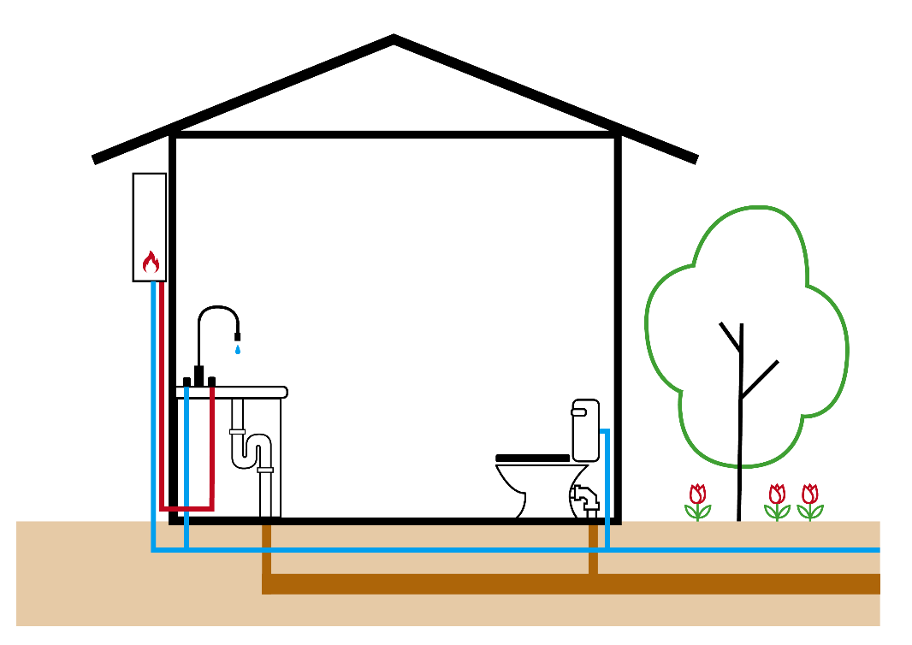
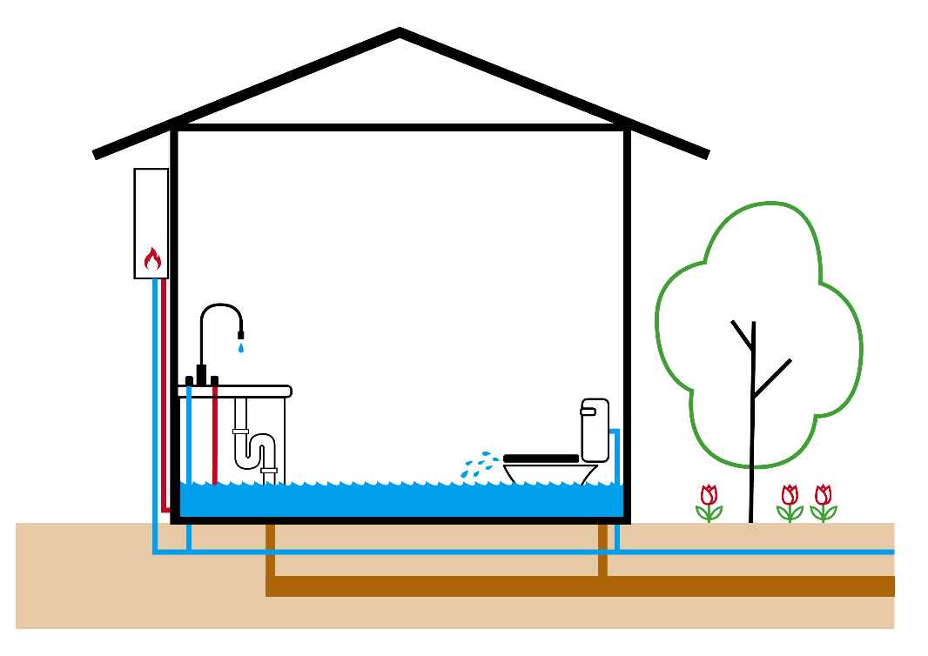
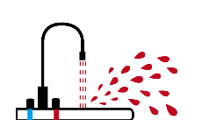
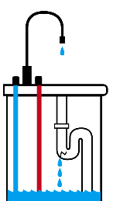
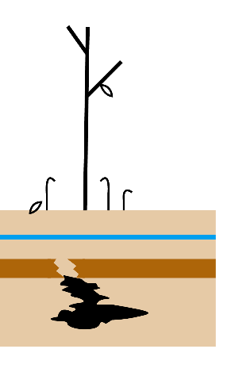
Risks from plumbing and drainage products
NCC provisions aim to ensure that plumbing and drainage installations:
Are safe for building occupants
Don’t result in damage to the building, infrastructure or the environment
Encourage efficient water use
What kinds of risks can arise from plumbing and/or drainage products?
Risks to health from contaminated drinking water
Risks to safety, e.g. burns from hot water or products that become too hot
Risks to property, health, safety or the environment from leaks, contamination, malfunctioning products, excess water pressure
Risk of contamination or blockage of water supply or drainage infrastructure
Wasteful use of water and/or energy, and unnecessary costs
To manage these risks, a building needs:
A safe and reliable supply of drinking water, which is the responsibility of the relevant water supplier
Drinking water delivered through plumbing and drainage products that are:
  Fit for purpose, which is achieved through certification under the WaterMark Scheme; and
  Installed correctly, which is achieved through the provisions of the PCA, and state/territory licensing and inspection requirements
To achieve this a building needs:
A safe and reliable supply of drinking water
Delivered through appliances, fixtures and fittings that are:
  Fit for purpose, and
  Installed correctly
Notes:
Slide progression
This slide starts with the title only in the banner. The slide has several layers.
Layer 1:
Click once to see the top block of text.
Click a second time to see the bottom block of text and the image.
Layer 2:
Click a third time to see the Layer 2 text box.
Click on any bullet in Layer 2 to illustrate the risks on the image.
Click on the same bullet a second time to dissolve the illustrations.
Note that several of the bullets have a number of illustrations, so you will need to click multiple times to work through all of them and then dissolve the illustrations.
Layer 3:
Click a fourth time to see the Layer 3 text box.
Facilitator notes
This slide introduces discussion of the aims and risks that lead to the need for most plumbing and drainage products to have WaterMark certification. It aims to contextualise the remainder of the presentation by explaining and discussing the rationale behind the Scheme.
Bring up the Layer 1 content and discuss. Emphasise the 3 elements required to manage the risks associated with plumbing and drainage infrastructure.
Bring up the Layer 2 content and discuss. Use the illustrations associated with the different bullet points if you think they will be helpful, and/or to create interest.
Bring up the Layer 3 content and discuss.
The key takeaway is that the WaterMark Certification Scheme is designed to manage the risks associated with plumbing and drainage products, thereby contributing to the health and safety of building occupants and protection of property, infrastructure and the environment.
Some points you could make in the discussion are:
Plumbing and drainage products can pose a number of different types of risks, including risks to:
User/occupant health, for example poisoning and infections when:
Drinking water becomes contaminated with bacteria, viruses, microbes or pollutants. The backflow of contaminated water into the drinking water supply lines in one building can also flow to outlets in the same and neighbouring buildings.
Sewerage is not safely evacuated from buildings.
Noxious sewer gasses are permitted to enter buildings.
Safety, for example:
Burns can be caused by contact with boiling/very hot water or plumbing parts that are excessively hot.
Excess pressure can cause water to splash on people.
Leaks can cause water to pool and increase slips and falls, causing injuries.
Leaks can also cause the build up of mould, which is harmful to human health.
Infrastructure, including the:
Building, for example damage to floors, ceilings, walls, pipes, fittings etc from leaks and seepage.
Water infrastructure, such as damage to the water supply system or drainage system from failures in plumbing or drainage elements within a property, e.g. when a blockage causes damage.
The environment, such as when land, flora and/or fauna are affected by flooding or pollution from water/sewerage escaping, seeping, leaking from the plumbing or drainage system at a site/building.
Sustainability is also an issue.
Poor quality products can result in more water being used than necessary. Poor installation can result in leaks and seepage and other problems that waste water.
Power use can also be affected. If heated water is being wasted then more water needs to be heated overall, and heating water accounts for a substantial portion of the average electricity usage of a typical Australian home (less so in commercial, non-residential buildings). Less efficient water appliances also use more power.
Ensuring that plumbing and drainage installations are safe involves ensuring that the:
Water supply is safe for use.
Sewerage is safely evacuated for treatment.
Plumbing and drainage products are appropriate and safe for use.
Plumbing and drainage products are installed correctly.
Water suppliers are responsible for the quality and reliability of water supply.
The suitability of plumbing and drainage products is managed through WaterMark certification.
Installation is managed through the provisions of the PCA, and state and territory approval and inspection regimes, where appropriate.

Slide 5
WaterMark product category risk assessment
All plumbing or drainage products to be used in a plumbing or drainage installation in Australia must undergo a risk assessment
If a product type is assessed as posing a medium to high risk that must be managed, that product type will:
  Require WaterMark certification
  Be listed in the WaterMark Schedule of Products
If a product type is assessed as posing a
low risk, that product type will:
  NOT require WaterMark certification
  Be listed in the WaterMark Schedule of Excluded products
WaterMark Schedule of Products
This schedule includes product types assessed as having a medium to high risk of health, safety, economic and wastage of water/energy consequences
WaterMark Schedule of
Excluded Products
This schedule includes product types assessed as having a low risk of health, safety, economic and wastage of water/energy consequences
Notes:
Slide progression
This slide starts with the title in the banner and the left hand block of text visible on the slide.
Click on either underlined term to see a popup expansion box that explains that term and lists examples of product categories that would be listed on that Schedule.
Click on a term a second time to collapse the expansion box.
MAKE SURE THAT YOU CLOSE EACH POPUP EXPANSION BOX BEFORE YOU OPEN THE NEXT ONE because they write over the top of each other.
Press Enter to progress to the next slide when ready.
Facilitator notes
The purpose of this slide is to introduce the idea of risk assessment for categories of plumbing and drainage products and the contents of the WaterMark Schedule of Products and the WaterMark Schedule of Excluded Products. This explains what the 2 Schedules contain and why a type of product ends up on one Schedule or the other one.
Discuss the content in the left hand block.
If helpful, select the highlighted terms and discuss the information and examples in the popup boxes about each Schedule.
Some points you could make in the discussion are:
As with other aspects of the NCC, Watermark certification is about effective management of the risks involved with construction. In this case, it relates to the risks that can arise from different types of plumbing and drainage products.
So, the WaterMark process actually starts with different types of plumbing and drainage products being assessed to determine the kinds of risks they pose and the severity of those risks.
Plumbing and drainage products that pose a significant risk are assessed as requiring WaterMark certification.
Those that don’t pose a significant risk don’t require WaterMark certification. This is explained further in later slides.
The ABCB maintains 2 WaterMark product schedules, both of which can be found on the WaterMark website (watermark.abcb.gov.au):
WaterMark Schedule of Products (WMSP): lists products that require WaterMark certification.
WaterMark Schedule of Excluded Products (WMEP): lists products which don’t need to have WaterMark certification.
If a product is not listed on either schedule, then a risk assessment must be completed to determine whether certification is required. The Risk Assessment Protocol is Appendix 3 of the Manual for the WaterMark Certification Scheme which can be found on the WaterMark website.
The Schedules don’t tell you whether a specific brand/model of a product type actually has been certified. You need to look elsewhere for this information, which is the subject of a later slide.

Slide 6
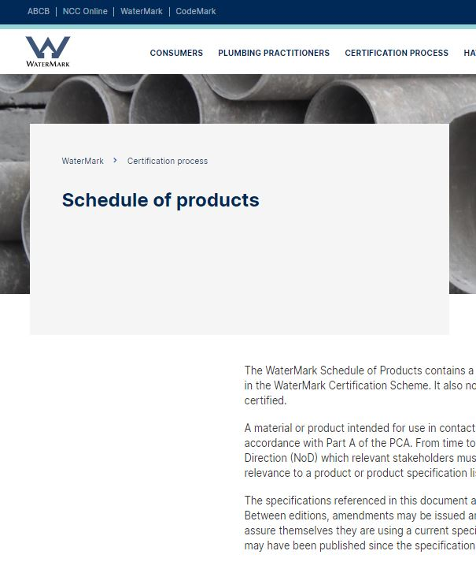
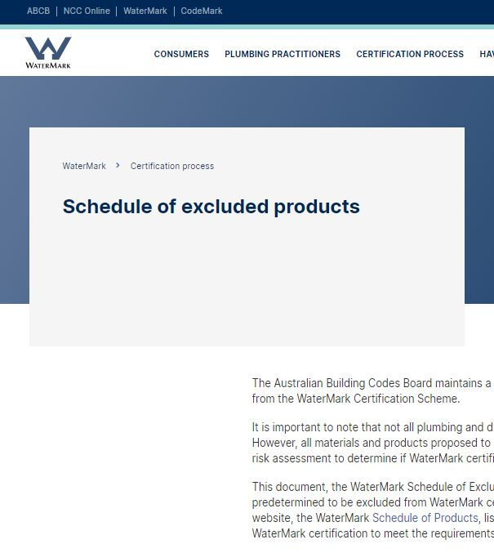
How do you know if a plumbing/drainage product requires WaterMark certification?
WaterMark Schedule of Excluded Products = product types assessed as having a low risk of health, safety, economic and wastage of water/energy consequences
Examples include:
  Evaporative coolers
  Bain maries
  Basins, baths and sinks
  Domestic refrigerators, and clothes and dish washing machines
  Some types of pipes, fittings and linings
  Sink strainers
WaterMark Schedule of Products = product types assessed as having a medium to high risk of health, safety, economic and wastage of water/energy consequences
Examples include:
  Appliances, e.g. commercial clothes and dishwashing machines
  Sanitary fixtures, e.g. bidets and cisterns
  Tapware, e.g. tap accessories, showerheads
  Devices and controllers
  Heated water products
  Valves, e.g. backflow prevention valves
  Jointing products, e.g. alloys and seals
  Pipes, e.g. metallic and plastic pipes
  Fittings, e.g. metallic and plastic fittings
WaterMark Schedule of Products:
If the product type is listed on this Schedule, then any product of this type that you specify, or install, must be WaterMark certified
WaterMark Schedule of Excluded Products:
If the product type is listed on this Schedule, then any product of this type that you specify, or install, does not need to be WaterMark certified.
Notes:
Slide progression
This slide starts with the question in the banner.
Click once to see the description of the WaterMark Schedule of Products and the image of that Schedule on the left hand side of the slide.
Click a second time to see the description of the WaterMark Schedule of Excluded Products and the image of that Schedule on the right hand side of the slide.
Click on either image to see an popup expansion box that explains the contents of the particular Schedule and lists examples of product types that would be listed on that Schedule.
NOTE THAT THESE ARE THE SAME BOXES AS APPEAR ON THE PREVIOUS SLIDE. THEY ARE REPEATED HERE IN CASE THEY ARE MORE USEFUL TO DISCUSS ON THIS SLIDE.
Click on an image a second time to collapse the expansion box.
Press Enter to progress to the next slide when ready.
Facilitator notes
The purpose of this slide is to discuss how the WaterMark Schedule of Products and the WaterMark Schedule of Excluded Products can be used to determine which types of plumbing and drainage products require WaterMark certification, and which ones don’t.
Ask the question and discuss the trainees’ responses. This gives more knowledgeable trainees the opportunity to demonstrate their knowledge.
Progress the slide and discuss the content in the left hand block.
Progress the slide again and discuss the content in the right hand block.
If and when helpful, select the highlight terms and discuss the information and examples in the popup boxes.
Some points you could make in the discussion are:
The WaterMark Schedules can be used to identify whether you need to look for a WaterMark certified product for particular installations.
For example:
If you are specifying or installing a hot water heater and you don’t know if it needs to be WaterMark certified, you can check these Schedules.
Hot water heaters are included in the Schedule of Products, so that means that they need to be WaterMark certified.
So, you need to make sure that the water heater you specify or install is certified.
Similarly:
If you are specifying or installing a new bain marie in a café, you can check these Schedules to find out if bain maries need to be WaterMark certified.
They are listed in the Schedule of Excluded Products, so you wouldn’t have to get a WaterMark certified product in this case.
Note that this doesn’t mean that the bain marie doesn’t have to meet any standards at all. Other regulations may apply to it and an approving authority might want to see evidence of suitability before they approve the installation.

Slide 7
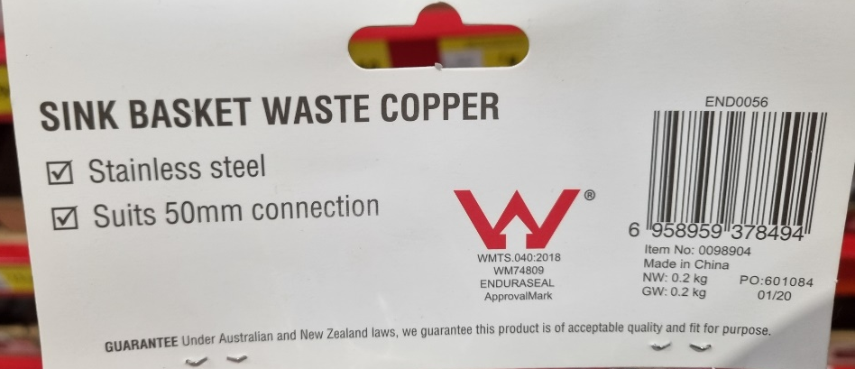
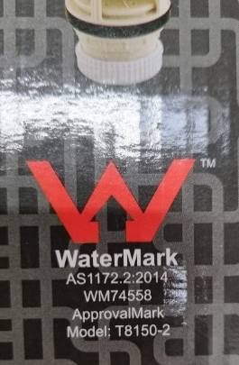
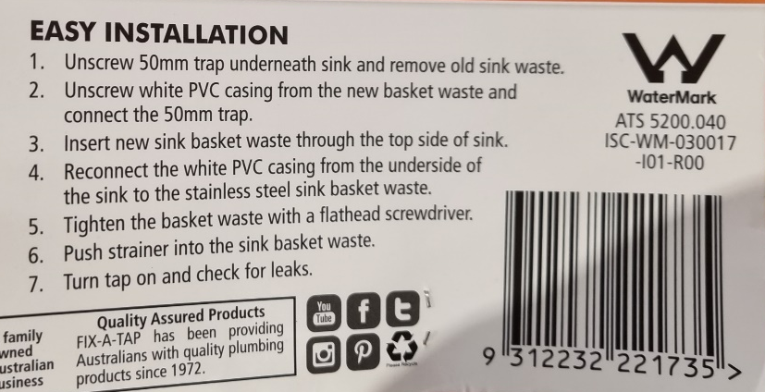
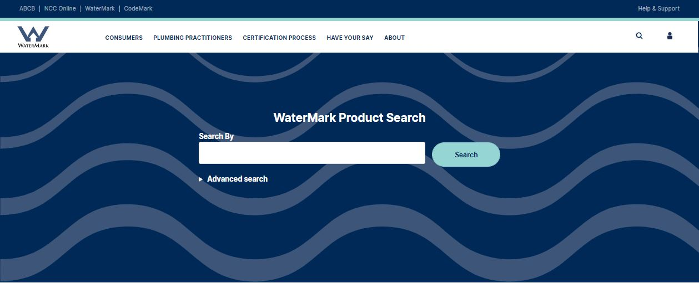
How do you know if a particular brand/model of a product is WaterMark certified?
To find out whether a particular brand or model of a plumbing or drainage product is WaterMark certified, you can:
Check the product and/or its packaging for the WaterMark trademark and product licence number
Look up the licence number and/or product name in the WaterMark Product Database
Notes:
Slide progression
This slide starts with the question in the banner only.
Click once to see the text on the left hand side of the slide.
Click a second time to see the images of WaterMark logos on the right hand side of the slide.
Click a third time to see the image of the WaterMark Product Database towards the bottom of the slide.
Click on the link on the WaterMark Product Database, to open the database on the WaterMark website.
Press Enter to progress to the next slide when ready.
Facilitator notes
The purpose of this slide is to discuss how the trainees can identify whether a particular brand or model of a product is certified under the WaterMark Scheme.
Ask the question and discuss the trainees’ responses. This gives more knowledgeable trainees the opportunity to demonstrate their knowledge.
Progress the slide and discuss the content in the left hand block.
Progress the slide again and discuss the content in the right hand block.
If you have the time, take the link to the database on the ABCB website and demonstrate how to search for products in the database in different ways.
Some points you could make in the discussion are:
The previous slides discussed how you could tell if a particular type of plumbing or drainage product needed to be WaterMark certified.
This slide is talking about how you can tell whether a specific brand/model of a product type actually has WaterMark certification. So, whether a particular tap, hose, pipe or other fitting that requires WaterMark certification is actually and currently WaterMark certified.
Only products with WaterMark certification are legally authorised to use the WaterMark trademark.
Products that have certification are required to include the logo, their licence number and the Specification to which they were evaluated on the product and/or the packaging.
The information should be on the product, if it is possible to include it on the product.
If it isn’t possible to put the information on the actual product, then the information needs to be included on the packaging. This would happen, for example, if the product was too small to include all this information.
So when a product is not installed, or is still in its packaging, then you should be able to easily see whether it is certified.
However, sometimes a product is installed already, or has become separated from its packaging, so you can’t check for the logo or licence number on the product/packaging. In these cases, you can use the WaterMark Product Database to check for current licencing information.
Similarly, if you are not sure whether an older product is currently licenced, you can check the database to see. For example, if client wants to use an old fitting that has been sitting around in their garage for a few years. The item might have a WaterMark logo, but it could also be that the requirements for that kind of product have changed and it is no longer certified for use. You can check the currency of its WaterMark certification using the WaterMark Product Database.
Note that certified products also need to display the Specification to which they were evaluated.

Slide 8
How does the WaterMark certification process work for new or innovative products?
When a manufacturer or supplier wants to sell a new or innovative plumbing or drainage product in Australia, there are 3 possible processes that they might need to follow.
1. The product type is listed in the WaterMark Schedule of Products, meaning it’s already been assessed as requiring WaterMark certification
2. The product type is listed in the WaterMark Schedule of Excluded Products, meaning it’s already been assessed as NOT requiring WaterMark certification
3. The product type does NOT appear on either the Schedule of Products or the Schedule of Excluded Products, meaning it needs to undergo a risk assessment to determine whether it requires WaterMark certification
Continue
Notes:
Slide progression
This slide starts with the question in the banner only.
Click once to bring in all the text and the 4 buttons on the slide.
This slide is a menu slide:
Each button jumps the presentation to a slide or section that covers a particular set of information.
From these other slides, you can jump back to this menu slide to look at the next section or continue the presentation. (Using the Back button at the bottom of those other slides.)
Click on each button to jump to another section of the presentation.
When you are ready to continue the presentation, click on the Continue button to jump to the rest of the presentation.
Facilitator notes
The purpose of this slide is to discuss how new plumbing and drainage products achieve WaterMark certification – if they require it – and what happens if they don’t achieve that certification.
This slide is designed as a menu slide to give you flexibility in how much time you spend talking about this topic and the order in which you do it. It is also designed to allow you to review the 3 possible options/versions of the process in between discussing each one. This helps the trainees to distinguish between the various processes and when each one applies.
Each button takes you to a different section of the presentation, where you can work through content related to that particular version of the process. You can return to this menu slide at the end of each slide, to select another version or continue the presentation.
Select the button for any version of the process to jump to the relevant slide in the presentation. Work through the material on that slide, then return to this menu slide to select the next/another version.
Note that you can also continue to progress linearly through the presentation to see each and every slide, by pressing Enter when you have finished presenting one slide to bring up the next one. If you do this, you will see the sections that relate to the 3 versions in order from version one to version 3, then the remaining slides in the presentation. If you do this, however, you won’t be able to return easily to this slide to see the 3 possibilities summarised together.

Slide 9
Products that require WaterMark certification
Product manufacturer/ supplier applies to
WMCAB for WaterMark certification for one or more products
WMCAB undertakes:
Annual product surveillance
Product
re-evaluation
5 yearly or when specification, design or manufacturing changes
If product is assessed as compliant, it is:
issued a WaterMark licence number
given a WaterMark Certificate of Conformity
listed in the WaterMark Product Database
Product must:
Carry WaterMark trademark and licence number on product and/or packaging
Provide a Scope of Use statement
Continue to meet standards over time
WMCAB assesses product against relevant Specification
WaterMark logo and licence number must be visible on product and/or the packaging
Scope of Use Statement describes conditions under which the product can be used
Scope of Use Statement must be provided with the product
WMCABs must re-evaluate all certified products against the Specification:
Before certification expiry every year
When informed by the manufacturer/supplier that the design or manufacturing of the product has changed
It is legal to sell a plumbing or drainage product that does not have a WaterMark licence
Can be used where no WaterMark certification is required
E.g. tap installed at a dam for watering stock
A product that fails when tested against the relevant Specification cannot receive WaterMark Certification
It does not get a WaterMark Certificate or licence, and it is not listed in the WaterMark Product Database
If a suite of products is assessed together, they will receive the same Watermark licence number
WaterMark Product Database lists all currently certified products and gives licence details
WMCAB = WaterMark Conformity Assessment Body
Accredited to evaluate products and issue WaterMark licences
Accredited by JAS-ANZ = Joint Accreditation System of Australia and New Zealand
See ABCB website for a list of WMCABs
Specification must be appropriate to the type of product and its use
Most specifications are AS/NZS Standards or WaterMark Technical Specifications, which have been developed by the ABCB
If product is assessed as NOT conforming, it does NOT get WaterMark certification
Product:
May still be sold in Australia
Cannot be used in installations where WaterMark certification is required
May be used in other installations
Back
Notes:
Slide progression
This slides starts with just the title visible in the banner.
Click once to bring in the first box in the flow chart, then continue to click to bring in the other boxes.
Boxes come onto the slide in the following order:
Blue, green then red boxes, AND
Left to right.
Click on any box to see a popup expansion box that provides some extra detail on that part of the process.
Click the Back button to return to the menu slide, with the 3 process options.
Facilitators notes
The purpose of this slide is to illustrate and discuss how products that require WaterMark certification are evaluated and certified.
Progress through the slide and discuss each stage of the process.
You can work through this slide in a variety of ways. For example, you could:
Bring in each process box and view the popup for each box as you go.
Bring in all the process boxes and then work through any of the popup boxes that you think would be helpful.
Bring in and discuss the process boxes and/or their expansion boxes in sets – first the blue boxes, then the green, then the red.
Emphasise that this is the process that is followed for products that are listed on the WaterMark Schedule of Products. These are product types that have already been risk assessed and have been found to pose sufficient risk to require WaterMark certification.
Return to the menu slide to view another process chart, or continue the presentation, when you are ready.

Slide 10
Products that don’t require WaterMark certification
Product type is listed in the WaterMark Schedule of Excluded Products
The product can be sold without WaterMark certification and can be installed by a licenced plumber
Its use may still pose risks to people and infrastructure
Its use requires another form of evidence of suitability, i.e. evidence that it otherwise meets the requirements of the PCA and conforms to relevant standards
Approving authority may not approve the
installation of a product without appropriate evidence of suitability
Part A5 Documentation of design and construction in the NCC contains requirements for evidence of suitability
This could include:
  A certificate issued by a relevant certification body stating that the product meets the requirements of the PCA, or
  A report from an Accredited Testing Laboratory that demonstrates that the product meets the requirements of the PCA and describes the testing completed to reach this conclusion
  Some other form of evidence acceptable to the approving authority
Back
Notes:
Slide progression
This slide starts with the title only in the banner.
Click once to see the left hand block.
Click a second time to see the right hand block.
Click the Back button to return to the menu slide.
Facilitator notes
The purpose of this slide is to illustrate and discuss what happens when a new product is of a type that DOESN’T require WaterMark certification.
Bring up the left hand block and discuss the content.
Then progress the slide to display the right hand block and discuss the requirements for appropriate evidence of suitability even when WaterMark certification is not required.
Emphasise that:
The fact that some types of plumbing and drainage products don’t need to have WaterMark certification, doesn’t mean that any product can be used or that these products don’t have to otherwise comply with PCA requirements or applicable Australian Standards.
All plumbing and drainage products must be fit for purpose, and some form of documentation will usually be necessary to demonstrate fitness for purpose.
The approving authority decides what kind of documentation is acceptable in each instance.
Return to the menu slide to view another process chart, or continue the presentation, when you are ready.

Slide 11
Products that require a risk assessment
WMCAB assesses risks associated with the product
If product is assessed as medium or high risk:
Product type is included on the Schedule of Products
Products of this type need WaterMark certification
Products of this type are evaluated using the approved Specification
Other suitable forms of evidence are described in Part A5 of the NCC Governing Requirements
E.g. another type of certificate or report from an accredited testing body
A suitable Specification might exist already, e.g. an existing Standard, and just requires approval for use in the Watermark Scheme
For new or innovative products, a new Specification might need to be developed
Risks could be associated with health, safety, economic and wastage of water/energy consequences
A medium risk to health and safety is enough to require WaterMark approval for the product type
The ABCB:
Lists the new Specification on the WaterMark Schedule of Products and WaterMark Product Database
May publish the Specification as a WaterMark Technical Specification
WMCAB follows the risk assessment procedure in the Manual for the WaterMark Certification Scheme
Appendix 3 Protocol for the Assessment of Risks of Plumbing Products
ABCB approves new / amended Specification
A draft Specification may be provided with the application to approve/develop a
new Specification
WMCAB may contract a suitable organisation to develop the Specification
If product is assessed as low risk:
Product type is listed in the Schedule of Excluded Products
Products of this type:
  Do NOT require WaterMark certification
  Require another form of evidence of compliance
See Products that require WaterMark Certification
WMCAB oversees development of new / amended Specification
If there is no applicable Specification to evaluate this type of product, the WMCAB nominates an existing, or develops a new / amended, Specification for the ABCB to approve
ABCB gives approval for development of new / amended Specification
Back
Notes:
Slide progression
This slides starts with just the title visible in the banner.
Click once to bring in the first box in the flow chart, then continue to click to bring in the other boxes.
Boxes come onto the slide in the following order:
Blue, red, then green boxes, AND
Left to right.
Click on any box to see a popup expansion box that provides some extra detail on that part of the process.
Click the Back button to return to the menu slide, with the 3 process options.
Facilitators notes
The purpose of this slide is to illustrate and discuss how new types of plumbing and drainage products that require a risk assessment are dealt with.
Progress through the slide and discuss each stage of the process.
You can work through this slide in a variety of ways. For example, you could:
Bring in each process box and view the popup for each box as you go.
Bring in all the process boxes and then work through any of the popup boxes that you think would be helpful.
Bring in and discuss the process boxes and/or their expansion boxes in sets – first the blue box, then the red box, then the green.
Emphasise that this is the process that is followed for types of plumbing and drainage products that do not appear on either the WaterMark Schedule of Products or the WaterMark Schedule of Excluded Products. These are types of products that have not yet been risk assessed.
This process identifies the likely risks of the particular type of products, and their possible consequences and assigns a risk rating to that type of product.
If the product type is determined to pose sufficient risk, then that product type is added to the Schedule of Products, and the individual model/brand is evaluated against a suitable Specification.
If there is no suitable Specification, then one must be developed or amended before the product can be evaluated.
If the product type is found not to pose a significant risk, then the product type is added to the Schedule of Excluded Products and no further evaluation is necessary.
Return to the menu slide to view another process chart, or continue the presentation, when you are ready.

Slide 12
What types of products are listed in…
…the WaterMark
Schedule of Excluded Products?
Plumbing and drainage products that:
Have been assessed as having a
low risk of health, safety, economic and wastage of water/energy consequences
Do NOT need to have WaterMark certification
Notes:
Slide progression
This slide starts with all the text and image visible on the slide, except for the answer to the question.
Press Enter to bring up the answer to the question in a blue highlight box at the bottom of the slide.
Facilitators notes
The purpose of this slide is to review and reinforce the purpose and contents of the WaterMark Schedule of Excluded Products.
Ask the question on the slide and discuss the trainees’ answers.
At the appropriate time, bring up the answer to the question and discuss the trainees’ answers.
Note that the next slide deals with the WaterMark Schedule of Products.
Emphasise that:
Just because a product doesn’t need WaterMark certification doesn’t mean that it doesn’t have to meet any standards at all.
Such products still have to be fit for purpose under the PCA and show appropriate evidence of suitability, in line with Part A5 of the NCC Governing Requirements.
Answer:
Plumbing and drainage products that:
Have been assessed as having a low risk of health, safety, economic and wastage of water/energy consequences
Do NOT need to have WaterMark certification

Slide 13
What types of products are listed in…
…the WaterMark Schedule of Products?
Plumbing and drainage products that:
Have been assessed as having a medium to high risk of health, safety, economic and wastage of water/energy consequences
MUST have WaterMark certification
Notes:
Slide progression
This slide starts with all the text and image visible on the slide, except for the answer to the question.
Press Enter to bring up the answer to the question in a blue highlight box at the bottom of the slide.
Facilitators notes
The purpose of this slide is to review and reinforce the purpose and contents of the WaterMark Schedule of Products.
Ask the question on the slide and discuss the trainees’ answers.
At the appropriate time, bring up the answer to the question and discuss the trainees’ answers.
Emphasise that:
If a category of product requires WaterMark certification, then you cannot specify or install a particular product of that category that is not certified.
WaterMark certification constitutes acceptable documentation that a plumbing or drainage product is fit for purpose according to the requirements of the PCA.
Answer:
Plumbing and drainage products that:
Have been assessed as having a medium to high risk of health, safety, economic and wastage of water/energy consequences
MUST have WaterMark certification

Slide 14
How can you find out if a product has a current WaterMark certification?
Sorry, there’s a more accurate answer. Please try again.
Look for the trademarked WaterMark symbol
on the product or packaging.
Sorry, there’s a more accurate answer. Please try again.
Look for a WaterMark licence number on the
product or packaging.
Sorry, there’s a more accurate answer. Please try again.
Check whether the product is listed in the
WaterMark Product Database.
Yes, that’s right. You can use all of these methods to determine whether a product has a current WaterMark certification.
All of the above.
Notes:
Slide progression
This slide starts with the question in the banner and a list of possible options below.
Click on any option or its radio button to see a popup response.
Click each option/radio button a second time to remove the popup.
Be careful not to click outside the options, or you may inadvertently progress to the next slide.
Click anywhere else on the slide or press Enter to progress to the next slide.
Facilitator notes
The purpose of this slide is to reinforce the different ways that you can check whether a plumbing product has WaterMark certification.
Ask the trainees how they would check whether a particular product has a current WaterMark certification and discuss their answers.
Select an option to see the response in a popup.
Correct answer: All of the above
“Yes, that’s right. You can use all of these methods to determine whether a product has a current WaterMark certification.”
Incorrect answers: All other options.
“Sorry, there’s a more accurate answer. Try again.”

Slide 15
Complete the sentences below…
significant
Plumbing and drainage products that pose a _________ risk of health, safety, economic and wastage of water/energy consequences must be certified under the WaterMark Scheme.
You can look up the details of specific products certified under the WaterMark Scheme
in the _________________________.
WaterMark Product Database
risk assessment
A new or innovative plumbing/drainage product must undergo a ______________ to identify whether it requires WaterMark certification.
Product types that require WaterMark certification are listed in the WaterMark _________________________. Product types that don’t require certification are listed in the WaterMark ___________________________.
Schedule of Products
Schedule of Excluded Products
Notes:
Slide progression
This slide starts with the instruction in the banner and 4 sentences below. Each sentence has one or more words or phrases missing.
Click on any sentence or its radio button to see a popup which contains the missing term.
Be careful not to click outside the 4 sentences, or you may inadvertently progress to the next slide.
Press Enter to progress to the next slide.
Facilitator notes
The purpose of this slide is to reinforce some of the elements of the WaterMark Scheme by asking the trainees to select the correct term to complete each statement.
Read each sentence, leaving out the term required, and ask the trainees to suggest the missing term. Discuss their answers, if they are not correct. Refer them to the ABCB website to check details if necessary.
Select each sentence to see the appropriate term appear in the sentence.
A key distinction to reinforce here is that the risk assessment process applies to categories of products, while an individual product goes through an evaluation against a Specification, based on the category of product it belongs to.
Answers:
Option 1: Plumbing and drainage products that pose a significant risk of health, safety, economic and wastage of water/energy consequences must be certified under the WaterMark Scheme.
Note that if the trainees suggest that the response involves products with a medium to high risk, this is also acceptable.
Option 2: You can look up the details of specific products certified under the WaterMark Scheme in the WaterMark Product Database.
Option 3: A new or innovative plumbing or drainage product must undergo a risk assessment to identify whether it requires WaterMark certification.
Option 4: Product types that require WaterMark certification are listed in the WaterMark Schedule of Products. Product types that don’t require certification are listed in the WaterMark Schedule of Excluded Products.

Slide 16
What is the purpose of a WaterMark risk assessment?
Sorry, that’s not right.
Please try again.
To identify whether a particular product complies with the relevant Specification.
Yes, that’s right.
A risk assessment is used to determine whether a new or innovative plumbing or drainage product presents risks that need to be managed through WaterMark certification.
To identify whether a type of plumbing or drainage product requires WaterMark certification.
To develop a Specification for assessing a new or innovative plumbing or drainage product.
Sorry, that’s not right.
Please try again.
Sorry, that’s not right.
Please try again.
All of the above.
Notes:
Slide progression
This slide starts with the question in the banner and a list of possible options below.
Click on any option or its radio button to see a popup response.
Click each option/radio button a second time to remove the popup.
Be careful not to click outside the options, or you may inadvertently progress to the next slide.
Click anywhere else on the slide or press Enter to progress to the next slide.
Facilitator notes
The purpose of this slide is to review the purpose of the WaterMark risk assessment process. In particular, it reinforces the distinction between a risk assessment, which relates to a new or innovative product type, and a WaterMark evaluation which is completed for a particular model or brand of plumbing or drainage product.
Ask the trainees the question in the banner and discuss their answers.
Select an option to see the response in a popup.
Note that development of a new or amended Specification may result from the risk assessment process, but it is not the purpose of the risk assessment process.
Correct answer: To identify whether a category of plumbing or drainage products requires WaterMark certification.
“Yes, that’s right. A risk assessment is used to determine whether a new or innovative plumbing or drainage product presents risks that need to be managed through WaterMark certification.”
Incorrect answers: All other options.
“Sorry, that’s not right. Please try again.”

Slide 17
True or false?
Yes, that's right.
A product that doesn’t have WaterMark certification can be legally sold in Australia.
However if the product is listed in the WaterMark Schedule of Products, but not WaterMark certified, a licenced plumber cannot install the product.
If the product is DIY installed, the plumbing regulator may not accept its installation.
Sorry, that's not right.
A product that doesn’t have WaterMark certification can be legally sold in Australia.
However if the product is listed in the WaterMark Schedule of Products, but not WaterMark certified, a licenced plumber cannot install the product.
If the product is a DIY installation, the plumbing regulator may not accept its installation
A plumbing product that
doesn’t have WaterMark certification cannot be sold or installed in Australia.
True
False
Notes:
Slide progression
This slide starts with the question in the banner, and a statement below, with options of True and False with radio buttons.
Click once on either the True or False option (or the radio button for either) to see a response.
Click again on the same option to get rid of the response.
Click Enter to progress to the next slide.
Facilitator notes
The purpose of this slide (and others) is to review the content of the module.
Ask the question and discuss the trainees’ answers.
When you are ready, click either True or False to bring up an answer.
Emphasise that:
Most plumbing and drainage products require WaterMark certification, but not all of them do.
A product type that is listed in the WaterMark Schedule of Excluded Products doesn’t need to have WaterMark certification.
However, an approving authority might require some other form of evidence that the product is fit for purpose.
Correct answer: False.
Yes, that's right.
A product that doesn’t have WaterMark certification can be legally sold in Australia.
However if the product is listed in the WaterMark Schedule of Products, but not WaterMark certified, a licenced plumber cannot install the product.
If the product is a DIY installation, the plumbing regulator may not accept its installation.
Incorrect answer: True.
Sorry, that’s not right.
A product that doesn’t have WaterMark certification can be legally sold in Australia.
However if the product is listed in the WaterMark Schedule of Products, but not WaterMark certified, a licenced plumber cannot install the product.
If the product is a DIY installation, the plumbing regulator may not accept its installation.

Slide 18
Yes or no?
Tapware is listed in the WaterMark Schedule of Products.
A particular tap doesn’t have a WaterMark licence.
Can this tap be used in a plumbing and drainage installation in Australia?
No, that’s not right.
The tap cannot be legally installed in Australia.
As taps are listed on the Schedule of Products, only a WaterMark certified tap can be installed by a licensed plumber.
If the tap is not WaterMark certified, it is not authorised for installation.
Yes, that’s right.
The tap cannot be legally installed in Australia.
As taps are listed on the Schedule of Products, only a WaterMark certified tap can be installed by a licensed plumber.
If the tap is not WaterMark certified, it is not authorised for installation.
Yes
No
Notes:
Slide progression
This slide starts with the question in the banner, and a statement below, with options of Yes and No with radio buttons.
Click once on either the Yes or No option (or the radio button for either) to see a response.
Click again on the same option to get rid of the response.
Click Enter to progress to the next slide.
Facilitator notes
The purpose of this slide (and others) is to review the content of the module.
Ask the question and discuss the trainees’ answers.
When you are ready, click either Yes or No to bring up an answer.
Emphasise that:
A product in a category that is listed in the WaterMark Schedule of Products must have WaterMark certification.
If a product that fits into such a category doesn’t have WaterMark certification, this means that either:
The manufacturer/supplier has never applied for certification for the product.
The product failed the evaluation for certification.
The product was certified in the past, but failed to retain its certification.
Regardless of the reason, a tap without a WaterMark can’t be used in any installation that is governed by the requirements of the PCA (NCC Volume Three).
It can, however, be used in another installation, which is not governed by the rules of the PCA. This would probably mean in an installation in which it would not be in contact with drinking water. For example, to bleed the radiators/convectors in a hydronic heating system, or to empty a boiler tank.
The tap would have to meet any requirements for the installation it would be used in. The specifier/installer would have to satisfy any approving authority that it met these requirements, and might have to provide some alternative form of certification.
Correct answer: Yes.
Yes, that’s right.
The tap can be sold legally in Australia.
However, as taps are listed on the Schedule of Products, only a WaterMark certified tap can be installed by a licensed plumber.
If the tap is not WaterMark certified it is not authorised for installation.
Incorrect answer: No.
No, that’s not right.
The tap can be sold legally in Australia.
However, as taps are listed on the Schedule of Products, only a WaterMark certified tap can be installed by a licensed plumber.
If the tap is not WaterMark certified it is not authorised for installation.

Slide 19
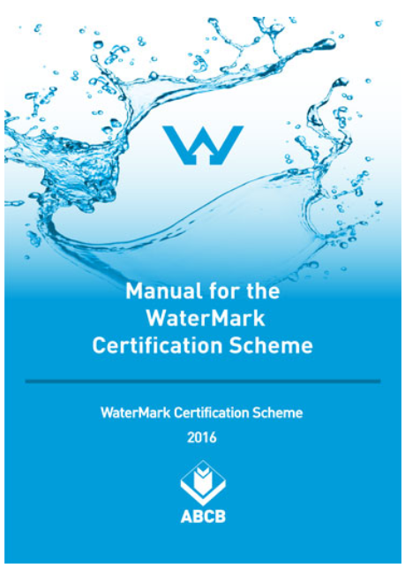
Useful resources
Key information on the WaterMark Certification Scheme can be found on the ABCB website:
  WaterMark Product Database
  Schedule of Products
  Schedule of Excluded Products
The Rules and Administrative procedures for the Scheme can be found in the Manual for the WaterMark Certification Scheme
Handouts:
  WaterMark Information Brochure
  WaterMark Certification Process Flowchart
YouTube videos:
  What is WaterMark?
  Look for the WaterMark
Notes:
Slide progression
This slide starts with the title in the banner.
Click once to see the left hand block of text which lists key resources for the Scheme.
Click a second time to see the centre block which contains a link to the WaterMark Manual.
Click a third time to see the right hand block of text which lists other available support materials.
Press Enter to progress to the next slide.
Facilitator notes
The purpose of this slide is to discuss resources that may help the trainees to use and understand the WaterMark Certification Scheme.
Bring up each block of text and discuss the resources that are listed on it.
If helpful, you can take the links to the linked documents/locations on the ABCB/WaterMark website. You could demonstrate how to download these documents and how to query the database, if you didn’t do this earlier in the module.
Emphasise that:
The WaterMark website has key information about the Scheme and many other useful resources.
The Database and Schedules are maintained, and updated regularly, on the website. The Manual is current and comprehensively covers the WaterMark certification requirements.
The handouts and videos provide supporting information only.

Slide 20
Summary
WaterMark Scheme is designed to ensure safety and efficiency of plumbing and drainage products in Australian buildings
WaterMark certification is one form of evidence of suitability under
Part A5 of the NCC Governing Requirements
WaterMark certification is required for any plumbing and drainage product that poses a medium
to high risk to:
Health and safety
Economic impacts
Wastage of water or energy
Schedule of Products lists product types that require WaterMark certification
Schedule of Excluded Products lists product types that do NOT require WaterMark certification
Notes:
Slide progression
This slide starts with the main heading and the leftmost block, with the first dividing line.
Click once to bring up the centre block.
Click a second time to bring up the rightmost block.
Facilitator notes
The purpose of this slide is to summarise the key content of the module briefly, in order to reinforce that content.
Briefly discuss the contents of the slide.

Slide 21
Key points
Licensed products must:
Display the WaterMark trademark, licence number and specification
Be provided with a Scope of Use
Undergo annual surveillance and be re-evaluated 5 yearly or when the applicable specification changes
A Watermark Conformity Assessment Body evaluates a product type against the applicable specification listed on the WaterMark Schedule of Products. This can be an Australian/International Standard or a WaterMark Technical Specification
A product that conforms is:
Licensed to use the WaterMark trademark
Issued a WaterMark licence number and Certificate of Conformity
Listed in WaterMark Product Database
Unlicensed products can be sold in Australia, but only if the product type:
Is listed in the Schedule of Excluded Products, OR
Is used in an installation not covered by the PCA provisions
Notes:
Slide progression
This slide starts with the main heading and the text in the top left block, with the first 2 dividing lines.
Click once to see the bottom left block appear.
Click a second time to see the top right block appear.
Click a third time to see the bottom right block appear.
Facilitator notes
The purpose of this slide is to summarise some of the key points in the module briefly.
Briefly discuss the contents of the slide.

Slide 22
Conclusion
Notes:
Slide progression
This slide starts with the questions heading and 3 images.
Facilitator notes
The purpose of this slide is to act as a non-intrusive background while giving trainees the opportunity to ask any final questions.

